Slide 1


The Role of Teaching Assistants in the classroom
Notes:
I have merged ‘encouraging independence’ and TA roles within the class. I have also tried to make it relevant for 1:1 TA’s and general TA’s as the strategies work well with all children.

Slide 2

What is the role of the teaching assistant?
TA’s are often on the front line with these children
Making decisions as they are supporting
Often with the children who need the most specialist support
Sometimes have to work with groups they are not as familiar with as well (switching from those most needy to the MA)
Have to adapt the curriculum/planning as they go along
Do not have enough time to communicate effectively with teachers – preparation or reflection
Notes:
Discussion of the role

Slide 3

The Role of the Teaching Assistant
‘The assistant acts as a bridge, helping with what they need to do to get from where they are currently to where they want to be. An assistant may ensure different learning styles are adopted, perhaps kinaesthetic, visual, practical, or act as a scribe or amanuensis to help the child achieve the learning objectives.’

Slide 4


A bridge to learning
TA Role
Teacher Support

Slide 5
What do teaching assistants need?
Good subject knowledge
Understanding of how children learn, pedagogy
Effective questioning techniques
Understanding of how to use and where to find resources
Behaviour management and de-escalation strategies
Knowledge of SEND – challenges and motivators
Initiative and spontaneity
Skills to encourage independence and good learning behaviours
Good communication skills, ability to engage, model, enthuse
Preparedness – do you know what pupils need to do and how?

Slide 6
What can happen during the teaching input?
Pupils become dependent on the ‘second input’ and therefore don’t listen to the teacher.
They don’t engage or join in with the input
TA feels they are not able to support as it may distract and need to be in the background
The balance between teacher engaging with the pupil and TA can be unequal

Slide 7

How to provide active support
(support during whole class inputs)
Scribing answers or vocabulary
Prompting with visual resources
Let TA’s know the main points
Write main points on a whiteboard for later
Modelling the use of resources such as Numicon, protractor, vocabulary cards
Mind mapping – this will aid the follow up independent task
Prompting with vocabulary cards or pictorial information
Observe pupil responses for teacher/use observation form to assess how well pupil is engaged in lesson
Notes:
Handout – What can I do during the input
This should be in planning but would be easier to provide a generic bank of ideas

Slide 8
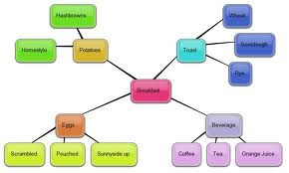
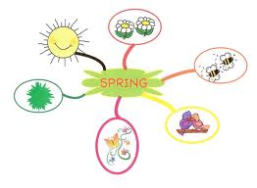
Mind mapping
All abilities
All ages
Made for pupil or by pupil

Slide 9
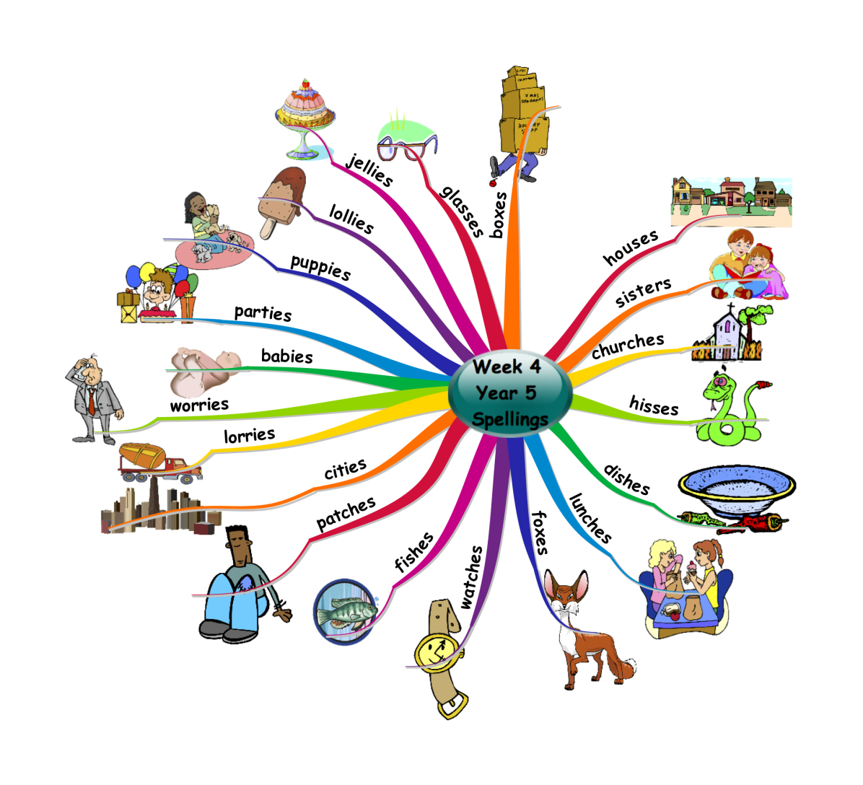
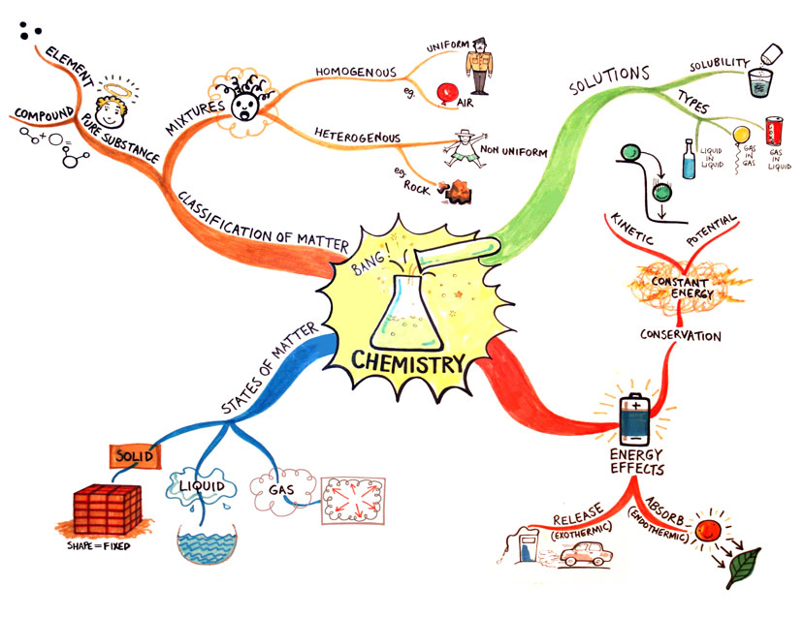
visual
memorable
logical
organised

Slide 10
Why should pupils be independent learners?

Slide 11
Less is more
‘Helping a child develop independence in all aspects of life is a key part of the role and this includes allowing a child to make mistakes and to look for ways to solve problems rather than just being told the right answers or solutions. Rather than taking over when a child is struggling to achieve something, they will offer the tools to help the child to succeed.’

Slide 12
‘The success of TA/LSA support is dependent on close liaison between the teaching staff and the whole school's determination that the pupil be a fully included member from the outset. What must be avoided is the situation where an assistant is 'glued' to the side of a pupil, in the mistaken belief that this is the only way of giving adequate support.’

Slide 13
Nothing could be further from the truth, as this leads only to dependency, reduced interaction between the teacher and the pupil and their peers, and lowered self-esteem. Effective support will enable the pupil to develop the skills necessary to become an independent learner, competent, confident and valued within the school and the wider community.’

Slide 14
Facilitating Independence
TA’s could ask the following questions;
How can you find out about?
What do you know already that could help you?
What did you do when you got stuck before?
Who else could help you? (peer support)
What could you tell me (teach me) about…?

Slide 15

What is the purpose of questions?
?
?
?
?
To interest, engage and challenge pupils;
To check on prior knowledge and understanding;
To stimulate recall, mobilising existing knowledge
and experience in order to create new understanding
and meaning;
To focus pupils’ thinking on key concepts and issues;
To help pupils to extend their thinking from the concrete and factual to the analytical and evaluative;
To lead pupils through a planned sequence which progressively establishes key understandings;
To promote reasoning, problem solving, evaluation and the formulation of hypotheses; to promote pupils’ thinking about the way they have learned.

Slide 16
Bloom’s taxonomy of questioning
?
?
?
?
Knowledge – describe, identify, who, when, where
Comprehension – translate, predict, why
Application – demonstrate how, solve, try it in a new context
Analysis – explain, infer, analysis
Synthesis – design, create, compose
Evaluation – assess, compare/contrast, judge

Slide 17
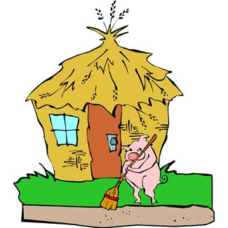
Bloom’s taxonomy of questioning
?
?
?
?
Knowledge – What happened in the story?
Comprehension – Why did the three little pigs leave home?
Application – What would you have built your home from?
Analysis – Which part of the story did you like best?
Synthesis – Can you think of a different ending?
Evaluation – How would you defend the wolf’s action?

Slide 18

Devising Questions
?
?
?
?
Devise questions that –
Challenge common misconceptions
Create conflict that requires discussion
Explore ambiguity and encourage discussion and clarification

Slide 19

Research about wait time
?
?
?
?
When teachers prolong their wait time between these
exchanges to pauses of three seconds or longer, a number
of effects are achieved including the following:
Pupils give extended answers
More pupils are likely to offer and answer
The number of “I don’t know” responses decreases
The responses that are given are more creative and thoughtful
The frequency of questions raised by pupils increases
The frequency of responses from less able pupils increase

Slide 20

The reluctant pupil
?
?
?
?
Give them the rationale behind their need to respond
Develop their confidence and self-esteem – plenty of
specific praise
Give them a lower cognitive order question – recall/
knowledge/application. Bloom’s Taxonomy
Get them to use the “thumbs up” and
“thumbs down” signal.
Use plenty of positive body language.

Slide 21

The ‘I’ve done it…’ pupil
Extend and challenge through these questions;
Can you make a new one yourself?
How do you know?
What if…?
Can you teach someone else?
Where else have you seen?
What do you think?
Have you checked?
Can you challenge yourself against your targets?

Slide 22
Encourage children to ask questions
?
?
?
?
Show interest in pupil’s questions;
Use modelling – think aloud!
What am I going to say/write/do now? Why have I stopped?
What is my problem? What sort of problem is this? Where have I seen this before?
Who can help me? What do I need? What is the next step?
Is there a better way? What alternatives are there?

Slide 23
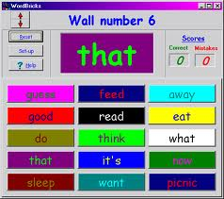


Effective questioning
Knowing what to do when
you don’t know what to do
Throw the responsibility back to the learner;
How could you find out?
What resources will you need?
Have a go!
Notes:
Handout – question prompts for TA’s

Slide 24

Effective Questioning cue card?
Complexity | Complexity
 |  | Is… | Did… | Will… | Would… | Can… | Might…
 | Who?
 | What?
 | Where?
 | When?
 | Why?
 | How?
Notes:
Show other prompt cards and blank levels

Slide 25
What is the purpose of an activity?
Avoid focusing on task completion – what are the learning objectives?
What learning should be focused on?
What are the learning priorities of the children?
Allow time for working on the task without your input
Choose the most appropriate points to intervene – could they work it out themselves?
Model task or do task next to them – I am going to write a sentence about my weekend
Verbalise your thoughts – ‘I will start at number 3 because I already have 3 and count in ones…4…5…6’

Slide 26
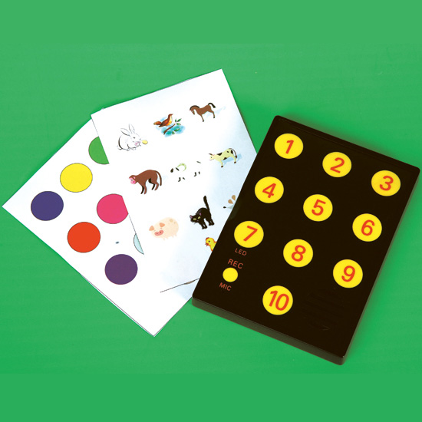
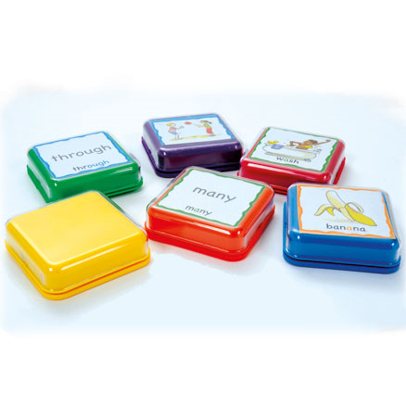
Scaffolding and supporting an activity
Writing frames
Visual resources and pecs
Word mats
Scribing to support
            Self help charters
            Timers and instructions
            Success criteria or editing list
            Targets and suggestions on how to meet them
            Dictionaries and displays

Slide 27
Facilitating independence during task time
Ask leading questions for pupils to obtain the answers
Prompting previous learning, use of resources and repeating main points of the lesson
Breaking down task using visual cues
Scribing or using writing frames, sentence starters, word mats, scaffolding with resources
Have resources to hand and train pupils to use them (checklist)
Timers – state the small task (chunking) and leave for 5 mins
Rewards for reaching small targets
Emphasise process rather than outcome
Correcting own work/reading work back to them for them to edit

Slide 29
Facilitating independence during group tasks
Preparing pupil so that they know what will happen and which part they will have to report back on
Pose questions or scaffold questions using blank levels, facilitate a part they can present to the class (rehearsal of this)
Join in with pupil discussion or take notes for the pupil to review later
Make sure pupils listen to each other and quieter children are given appropriate processing time
Use visual cues to prompt reluctant talker
Set them up with a buddy

Slide 30
Task
Stages of lesson | TA Role during lesson
Possible support during class input
Possible support during group task
Possible support during independent task

Slide 31

Further Independence for pupils
Activities that pupils can complete on their own
Activities based on their IEP targets
Pupils taught how to use activities
Activities that focus on repetition and consolidation
Independent Learning Boxes
Pupils should know their SAP targets
SAP targets should be visible and child friendly targets sheets used
Teachers should facilitate opportunities for pupils to use their independent learning boxes
Boxes should be accessible for pupils to use when they have finished main tasks (initiative)

Slide 32
Targets and pupil accountability
Adults should;
comment on pupil targets
facilitate discussion about personal learning
ask direct questions about whether targets have been met
prompt pupils to look at their targets
ask leading questions about how learning could be moved on
This could be done through;
Target Reviews
Learning reflections
Child friendly IEP’s
Pupil conferencing

Slide 33
What we need for our pupils
Effective questioning
Independence through small task chunking
Challenge and extending through intervention
Support through teacher input – scribing /main points/ mind mapping
Independent learning tasks/boxes
Assessment for learning/teachers marking
Resources – push buttons/talk tins/writing frames/words mats/cue cards/vocab books or sheets
Mind mapping
Targets and pupil independence – target reviews/learning reflections
Making use of SAP’s and Class Needs Analysis

