Slide 1
Sensory differences
Kelly Evans – Autism Advisor for Families

Slide 2
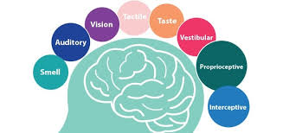
Processing the sensory world differently
8 senses…
Under (hypo) sensitivity
Over (hyper) sensitivity
Individual profile
Profile may fluctuate

Slide 3
Processing the sensory world differently
Having sensory differences is more than just having a different sensory experience
Sensory input has 2 functions, tells us what is out there in the world and to help regulate our level of arousal.
Sensory input can alert us (raise our level of arousal) or calm us (lower our level of arousal).
If you are over sensitive you are constantly being alerted; under sensitive and you are not being alerted enough…
Too much input can make you angry

Slide 4
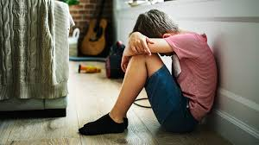
When the coping strategies don’t work…
Meltdown
Shutdown
Notes:
Can lead to…

Slide 5
An example of sensory overload
https://www.youtube.com/watch?v=K2P4Ed6G3gw

Slide 6
Touch
Over sensitive -
Forewarn the child before you touch him, by saying his name first and moving through his visual field to reach him.
Do not force the child to participate in messy play e.g. finger painting etc. but allow him alternatives such as using a paintbrush.
Allow the pupil to wear gloves so their skin does not have direct contact with the aversive texture.
Always approach from the front.
Brushing own hair
Different toothbrushes and /or toothpaste
Remember a hug may be painful rather than comforting.
Remove labels from clothing
Use firm pressure rather than light touch

Slide 7
Touch
Under sensitive –
Play dough
‘Theraputty’- hide toys inside it, squeeze and manipulate.
Cutting and sticking activities- collage etc.
Create an obstacle course of different textures e.g. a towel, carpet square, bubble wrap and allow the pupil to walk across them.
Therabands — use to pull and stretch.
Fidget toys
Weight bearing activities
Teach child about force
Weighted pencils

Slide 8
Taste - Foods
Do not remove preferred foods- hunger will not be a driving factor for change
It is important to avoid programmes of force feeding or starvation to encourage a more varied diet. The child has an increased sensitivity to certain food. It is not a simple behaviour problem where the child is being deliberately defiant (Attwood 1998)
Do not hide food or adapt preferred foods- likely these will then be rejected. However, if the child is nutritionally at risk this could be considered with very careful planning
Children on self-restricted diets are likely to be nutritionally compromised
‘Good enough diets’- relieve pressure of 5 a day
There are no good or bad foods.
Seek advice from a dietician re. supplements etc.
Expectations- try not to let children escape challenging situations. Be persistent- even if a food is rejected several times, keep trying.
Rewards- rewards should be rewarding! There needs to be a strong enough motivator

Slide 9
Food cont.
Distractions- it’s okay for them to watch the TV/iPad whilst eating
Toys at the table are okay- this can help them to eat more- strict boundaries can be unhelpful
Visual timetables- help them to feel prepared for meals in advance.
Continued exposure- engage in food related activities on a regular basis- play specialists could offer programmes- separate from meal times
Desensitisation- small steps
Break down the introduction of foods into manageable steps it can reassure the child and make them feel in control e.g. Place a new item of food on the table
The place a small piece on your child’s plate
Try to get them to touch it
Try to get them to hold it to their mouth
Food charts- this week I will try…, exploring new food chart.
List of good and bad foods and let the child to pick one from each list
Food books- pictures of foods that the child likes and dislikes- food they like at the front- as the child tries new foods the don’t like pictures move to the front
Use special interests
Encourage child to handle and prepare food

Slide 10
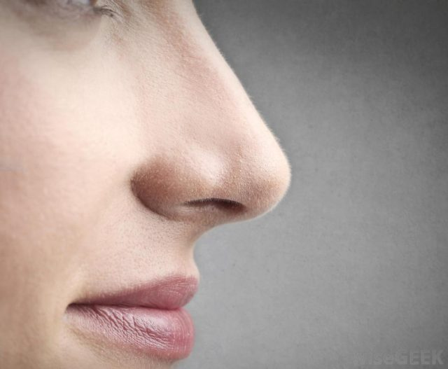
Smell
Under sensitive - Provide activities which stimulate the olfactory senses:
Playing in grass
Using scented play dough
Cooking with strong smells
Over sensitive -
Use fragrance-free cleaning products
Use unperfumed toiletries
Keep rooms well ventilated
Cover nose with tissue

Slide 11
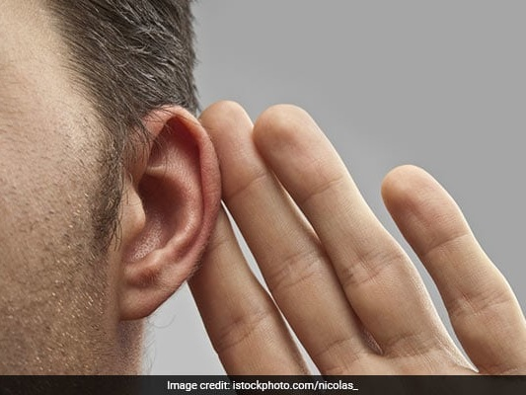
Auditory
Over sensitive -
Ear defenders
Pre warning of noise eg fire alarms
Listen to music while carrying out an activity
Ensure access to ‘quiet spaces’
limiting excessive noise where possible
Under sensitive –
Stand beside the student when giving instructions
Use a visual support to aid registration of instruction e.g. typed notes on a handout, pictures, keeping instructions on board.
Allow the child a longer time to respond when asking questions. Some may need extra quiet time to process information before responding to a question. Interrupting a child during this processing time can confuse their thought process.
Break complicated directions into fewer parts and give the child time to complete the first step before going on to the next part.

Slide 12
Visual
Over sensitive -
Areas clutter free
Clearly labelled items/toys/drawers
Exaggerated facial expressions when appropriate
Throwing and catching activities.
Fishing (paper clips on the end of paper fish- use a fishing rod with a magnet)
Use bubbles — pupils to chase and ‘pop’ the bubbles.
Under sensitive –
Allow access to visual stimulation at certain times during the day e.g. before and after independent work. This will then help the child to maintain an adequate level of alertness and attention throughout the day.
Use visuals to gain child’s attention.

Slide 13
Proprioception
This system is in our muscles, tendons, ligaments and joint receptors. It tells us where our body is in space and detects and controls force and pressure. It helps us to feel grounded and know where we are and what we are doing.

Slide 14
Seeking proprioceptive input?
Bites/chews on objects e.g. sleeve of jumper, pen/pencil
Hyperextends joints e.g. bending back fingers, locking knee joints
Bangs body parts e.g. bangs hands together, bangs jaw with hand
Holds objects with excessive pressure e.g. pencil; writes heavily on page
Enjoys rough and tumble play but can be excessively rough with others
Throws self heavily onto floor
Prefers to run, jump or stamp heavily when he/she should be walking
Likes to sit with knees tucked under himself/herself
Engages in weightbearing activities e.g. swinging on desks, climbing
Walks on tiptoes

Slide 15
Proprioceptive activities
Table/ Wall pushes (these are good to do within class)
Hanging from a pull up bar
Carrying a box or bag (heavy) of toys or work for next activity
Moving/Chair, rearranging furniture.
Sitting on an air cushion e.g. Movin’Sit Cushion or therapy ball.
Pushing/pulling boxes with heavier items in (you could make box into a ‘car’ or ship with rope to pull along)
Riding vehicles e.g. tricycles, bicycles & scooters
Jumping on trampette and /or Trampolines
Sitting bouncing on therapy ball with feet flat on the floor and/or support from adults at hips
Using a space hopper
Using playground equipment such as swings and climbing frames
Swimming.
Gardening.
For older children gym work, rock climbing, martial arts, boxing.

Slide 16
Vestibular
Vestibular input (balance): These receptors are in the inner ear and stimulation occurs through any change in position, direction or movement of the head. Vestibular input contributes to our sense of body position in space, posture and muscle tone, the maintenance of a stable visual field, bilateral co-ordination, a sense of equilibrium/balance and gravitational awareness.

Slide 17
Seeking vestibular input?
Climbs dangerously high, can’t seem to get high enough
Spins frequently (while standing, on swings, in swivel chairs)
Seeks out swinging
Never seems to get dizzy
Always moving, running

Slide 18
Vestibular sense – acvitites
Dance
Spinning
Kneeling on your knees
Laying on a couch
Crawling
Standing on a ladder
Laying on your belly to read a book
Walking on your tiptoes
Doing somersaults
Navigating monkey bars
Going up or down the stairs
Bouncing on a trampoline
Riding in an elevator
Driving down a hill in a car
Sliding on a sled
Rocking in a rocking chair

Slide 19
Interocpetion
Sometimes called the hidden sense, the interoceptive system gives us the ability to feel what is happening inside our body. It plays a role in influencing emotions and sense of wellbeing and detects changes in our internal state. These include hunger and fullness, thirst, body temperature, heart and breathing rates, social touch, muscle tension, itch, nausea, sleepiness and more.

Slide 20
Interoceptive sense
Find interoceptive input irritating? Young people who are hypersensitive to sensory input may overreact to interoceptive sensations. For instance, they may eat more than other kids to avoid feeling hunger pangs. They may also use the bathroom more often than necessary because they don’t like the way a full bladder feels.
Respond inappropriately to interoceptive input? Young people who are under-responsive to sensory input may not feel or respond to sensations when they should. They may take longer than other kids to learn to use the toilet or have more frequent accidents. They may not eat as often as others because they may not feel hunger or thirst

Slide 21
Interoception sense – activities
To help your child develop their body awareness and teach them to start tuning in to what their body feels like when it is balanced, incorporate these activities into their daily routine.
Yoga – focuses on listening to your body and providing good proprioceptive and vestibular input. It encourages you to look internally and focus on how the body and mind if feeling.
Mindfulness – gives the person time to focus on their body and emotional state.
Breathing exercises – like lazy 8. Breathing exercises are calming and also help us to pay attention to what is going on inside our bodies.
Heavy work activities – involve large muscles of the body. Proprioception is good for body awareness and also for interoception.
Alerting activities – to help you feel what a racing heart and fast breathing feels like.

Slide 22
Interoception
Use Body Talk: Label the way your body feels during daily activities (e.g., “My muscles feel loose when you cuddle me; my heart feels fast when I play tag with you”). Not only are you serving as a good model, but body talk also naturally tunes you in to your body signals.
Build Body Curiosity: Teach your child to notice how their body feels during daily activities (e.g., “how does this make your hands feel? How does this make your stomach feel?”)
Directly Teach that Body Signals are Clues to Emotions: (e.g., “you said your muscles are wiggly, and your voice sounds loud, what emotion could that mean?; You said your stomach is growling. That could be a clue to what emotion?; What does your heavy feeling eyes mean?”)

Slide 23
Questions?

