Slide 1
Year 6 Welcome Session

Slide 2
Who’s Who!
Ms Cooper – Executive Headteacher
Miss Stephenson and Miss Amin – Deputy Headteachers
Miss Demeza – SENDCo
Mrs Tohux – Upper Junior Phase Leader
Mrs McGall – Lower Junior Phase Leader
Miss Walley – Fs2 and KS1 Phase Leader

Slide 3
Who’s Who?
Year 6 teachers:
Mrs Booth (Birch)
Miss McClintock (Alder)
Mrs Tohux and Mrs Atkins (Cedar)

Slide 4
Inclusion and Pastoral Team
Miss Demeza – SENDCo and Inclusion Lead
Mrs Kirk – Family, Pastoral and Mental Health Lead
Miss Challis – SENDCo assistant and Speech and Language Specialist
Mrs Hawkins – Senior Mental Health Lead
Mrs Jezzard - ELSA
Miss Jutte - ELSA
Mrs Brown – ELSA
If you need any support, please contact Miss Demeza or Mrs Kirk. This can be done via the office.

Slide 5
Our Office
We have one office site for our Federation, based at JRI.
Please contact the office with queries. Emails can be sent to the office to be forwarded to class teachers.
There are members of classroom staff on the Year 6 doors in the morning and in the playground at the end of the day if you have a question or message.
All children who are ill during the day and need to be sent home should be picked up from the infant site office.
There is only one phone number for both schools and one email address should you need to contact us. 01635 42376
office@jrs.w-berks.sch.uk
If you are on Facebook, add our John Rankin page for updates.

Slide 6
General Organisation
We ask that children wear their PE kit to school on two days each week:
Mondays and Wednesdays are Year 6 PE kit days
If children are doing a Procision sports club after school they should come to school in school uniform and bring their kit to change into at the end of the school day.
Water bottles – please come to school with these filled and named. Water bottles should also be named and in school daily (not inside their book bag). The bottles will be refilled at school if needed. Water bottles must be spill proof and actual water bottles. They must only contain water please.
Lunches – please order these in advance electronically.
We ask that children in Year 6 bring in a pencil case containing basic equipment: black pen, pencil, ruler, glue, colouring pencils.
Concentration aid – If your child requires a concentration aid, please communicate this with the inclusion and pastoral team. Please don’t supply these from home as they could get lost or broken.

Slide 7
General Organisation
Drop off and pick up
Gates open at 8:30 am
Year 6 doors open at 8:35 am – 8:50am
Children arriving after 8:50 am should enter school via the infant office
Any children arriving at 9am or after will be marked as late
Home time is at 3:15
Gates will be open from 3:10. Children will be dismissed from the junior playground. Children with permission from parents have their own arrangements.

Slide 8
Walking to School
Please walk or cycle to school where at all possible.
Parking further out and walking in also helps.

Slide 9
Purple Learners

Slide 10
JRS Curriculum
Our curriculum is being developed this year to ensure the children across the school receive exciting and engaging learning. National curriculum requirements will be fully covered but we working on a JRS curriculum which does what our vision says: Ignite passion, empower learners and transform futures.
You will find details of what your children are learning each half term via medium term plans on the school website.

Slide 11
Big Ideas!

Slide 12
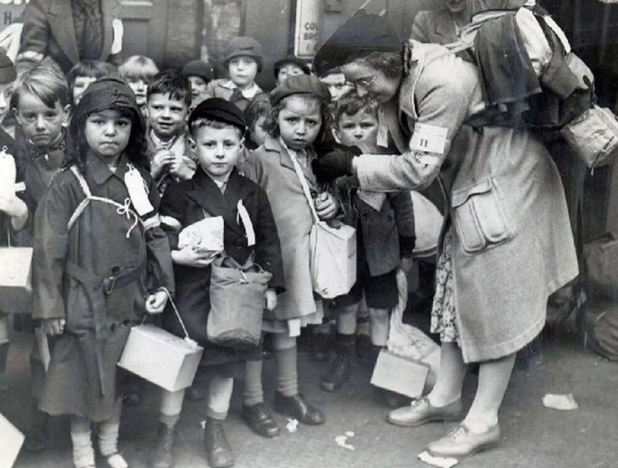
Brave New World
The ideas we will be exploring in Year 6 this half term are:
Imagine if… you lived in wartime Newbury. We will learn about WW2, including evacuees to Newbury and bombings in the town.
Imagine if… you were a travel writer.
We will be learning about some
different countries, and the
children will create their own
websites about the countries.

Slide 13
READING
Please can we request that all children are encouraged to read at home for at least 10 minutes daily.
Please can we ask that when reading at home with your child you:
talk to your child about reading, their preferences and interests;
discuss ideas and opinions about books they are reading, ask them to summarise stories, predict, explain characters, etc;
record what they have read in their Reading Record on a daily basis.
Please ensure your child has their reading diary at school every day. Books are changed at class teachers’ discretion.

Slide 14
Homework
Homework will be set on Google Classroom on a Friday.
Homework will be focused only on reading this year. There will be other optional learning available for all pupils, but the key focus will be on specific texts that are sent home weekly – for some pupils, this will be to explore the vocabulary, with specific teaching in school that will be related to the learning in class. We want our children to experience a broad range of rich and diverse texts and this will be one way to encourage this love of words and reading.

Slide 15
Our focus on reading…
Research shows the effects of reading on later literacy skills, facilitating social interaction between adults and children, and encouraging children to engage with the world around them. It also states how reading can be a ‘stable source of information’ throughout a child’s life. This stability allows them to access text in a constant fashion and can be especially beneficial for children growing up in challenging circumstances.

Slide 16
Rules Review
Last year, we spent time considering our values, rules and expectations.
Following input from staff and children, we now have three new rules for the whole school:

Slide 17
PTFA
*We have a wonderful, active PTFA who have raised a considerable amount of money for our school- most notably funding our Make it Bake it room, FS1 outdoor learning area and soon to come, an amazing KS2 adventure climbing area.
*They are always looking for willing volunteers to support them or run events.
*The first PTFA meeting was held last night. However, if you missed it but would still like to get involved, please email
johnrankinptfa@gmail.com

Slide 18
Rhos-y-Gwaliau
The school trip of a lifetime!
Two separate groups, in the first two weeks of the January term.
For many children, this trip will be the first time children have been away from their family for a significant time.
The week is designed to be full of exciting challenges for pupils.
It is an excellent opportunity for them to grow in independence, and to develop personal social skills, cooperation and teamwork.
The trip to RYG offers children a wide range of activities.
During the week, they could be:
Rock Climbing
Exploring slate mines
Gorge Walking
Mountain Walking
Map reading and Orienteering
Canoeing
During these activities, they will be covering aspects of the National Curriculum including Geography, P.E, PSHE, English, Maths and Science.

Slide 19
A week at Rhos
Sun | Travel | Arrive and welcome |  | Local walk
 |  | Briefing/kit issue
Mon | Group Activity – Mountain Hike |  |  | Lego Team Challenge
Tue | Group Activity – Canoeing and Gorge Walk |  |  | Swimming at local leisure centre
Wed | Group Activity – Mine exploration |  |  | Orienteering around the centre
Thu | Group Activity – Rock Climbing |  |  | Quiz Night
Fri | Map Reading Walk |  | Kit clean and return | Film and Feast Night
Sat | Tidy Centre and depart 10 am |  | Travel Home and return approx. 3.30pm

Slide 20
Food & Sleeping
Breakfast – All you can eat cereal, toast, fruit, yogurts, tea, water, juice
Lunch – Large roll filled by children (ham, chicken, beef, tuna, cheese, salad…), fruit, homemade cake/snack bar.
Dinners – Homemade soup
- Lasagne, fish and chips, roast chicken/beef, chilli con carne, lots of vegetables… pizza on the final evening.
- Homemade cakes, fruit crumbles, ice cream…
Evening – Hot chocolate
If your child has a special dietary requirement, please let teachers know and record on the child’s details sheet. The chef at the centre makes everything fresh and will cater for any needs as required (including fussy eaters).
Sleeping arrangements – Children will be sorted into same sex groups for sleeping in dorms. There are a range of size dorms and we carefully consider these arrangements.

Slide 21
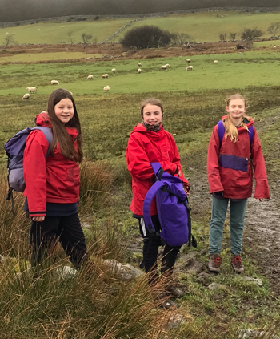
Equipment
The Centre will issue the following items to all
pupils for the week:
WATERPROOF CAGOULE
WATERPROOF TROUSERS
WINDPROOF JACKET
FLEECE JUMPER
WALKING BOOTS
WELLY BOOTS
LARGE BACK PACK
BALACLAVA (IF NEEDED)
(WATERPROOF GLOVES ARE AVAILABLE IF NEEDED)
Other items of equipment (e.g. helmets, buoyancy aid etc.) for the specialist activities programmed will be issued on a daily basis as appropriate.
PLEASE DO NOT GO OUT AND SPEND MONEY ON THESE ITEMS AS THE CENTRE’S EQUIPMENT IS VERY GOOD.
Generally children will only need to take under layers and clothing for the evening. A full kit list will be issued nearer the time of the trip.

Slide 22
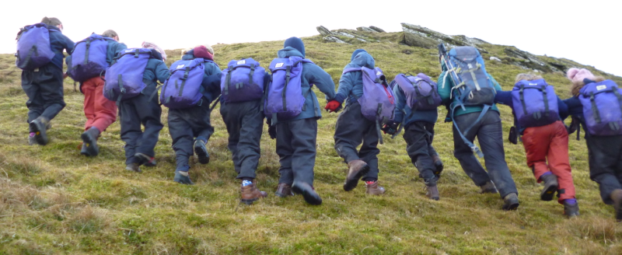
Rhos
Most importantly…
The children enjoy this trip and get a great deal of learning, confidence and maturity from it!
It is a trip they will never stop talking about!

Slide 23
Rhos Dates
Week 1 – Birch Class
Sunday 7th – Saturday 13th January 2024
Week 2 – Cedar and Alder Classes Sunday 14th – Saturday 20th January 2024

Slide 24
Thank you for attending this afternoon.
You will now have the chance to visit your child’s classroom for a general look and chat with the teacher. Parents evenings will be coming up later this term for more specific conversations about your child’s learning.
In the meantime, if you have any questions please don’t hesitate to contact the school office and these will be forwarded to us.
We look forward to working in partnership with you and your children this year.

