Slide 1

Key Stage 1
Welcome Session

Slide 2
Who’s Who!
Ms Cooper – Executive Headteacher
Miss Stephenson and Miss Amin – Deputy Headteachers
Miss Demeza – SENDCo
Mrs Tohux – Upper Junior Phase Leader
Mrs McGall – Lower Junior Phase Leader
Miss Walley – Fs2 and KS1 Phase Leader

Slide 3
Who’s Who?
Year 1 teachers – Miss Lancaster (Hazel), Mrs Conway (Holly), Mrs Rance and Mrs Malone (Laurel)
Year 2 teachers – Miss Spooner (Magnolia), Mrs Morse (Maple), Miss White (Mulberry)

Slide 4
Inclusion and Pastoral Team
Miss Demeza – SENDCo and Inclusion Lead
Mrs Kirk – Family, Pastoral and Mental Health Lead
Miss Challis – SENDCo assistant and Speech and Language Specialist
Mrs Hawkins – Senior Mental Health Lead
Mrs Jezzard - ELSA
Miss Jutte - ELSA
Mrs Brown – ELSA
If you need any support please contact Miss Demeza or Mrs Kirk. This can be done via the office.

Slide 5
Our Office
We have one office site for our Federation, based at JRI.
Please contact the office with queries. Emails can be sent to the office to be forwarded to class teachers.
There are members of classroom staff on the Year 1 and Year 2 doors in the morning and at the end of the day if you have a question or message.
All children who are ill during the day and need to be sent home should be picked up from the infant site.
There is only one phone number for both schools and one email address should you need to contact us. 01635 42376
office@jrs.w-berks.sch.uk
If you are on Facebook, add our John Rankin page for updates.

Slide 6
General Organisation
We ask that children wear their PE kit to school on two days each week:
  Tuesday and Thursday are Year 1 PE kit days
If children are doing a Procision club after school they should come to school in school uniform and bring their kit to change into at the end of the school day.
Water bottles – please come to school with these filled and named. Water bottles should also be named and in school daily (not inside their book bag). The bottles will be refilled at school if needed. Water bottles must be spill proof and actual water bottles. They must only contain water please.
Lunches – please order these in advance electronically. We will check every morning and can order if forgotten.
Children in Years 1 and 2 will be provided with equipment needed in school. We ask that they do not bring a pencil case to school, please.
Concentration aid – If your child requires a concentration aid, please communicate this with the inclusion and pastoral team. Please don’t supply these from home as they could get lost or broken.

Slide 7
General Organisation
Drop off and pick up
Gates open at 8:30 am
Year 1 and Year 2 doors open at 8:35 am – 8:50am
Please exit the playground via the one-way system
Children arriving after 8:50 am should enter school via the infant office
Any children arriving at 9am or after will be marked as late
Home time is at 3:10
Gates will be open from 3:10. Children will be dismissed onto the playground.

Slide 8

Walking to School
Please walk or cycle to school where at all possible.
Parking further out and walking in also helps.

Slide 9
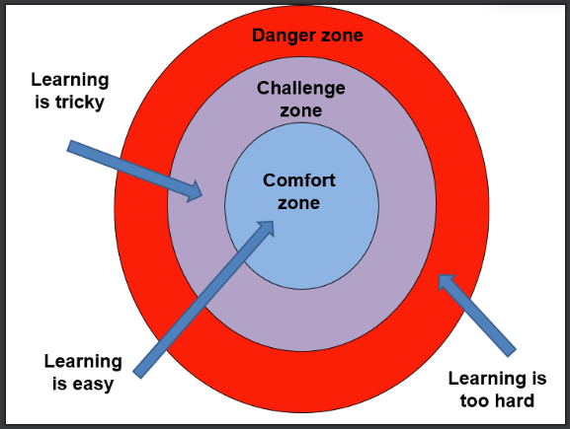

Purple Learners

Slide 10
JRS Curriculum
Our curriculum is being developed this year to ensure the children across the school receive exciting and engaging learning. National curriculum requirements will be fully covered but we are working on a JRS curriculum which does what our vision says: Ignite passion, empower learners and transform futures.
You will find details of what your children are learning each half term via medium term plans on the school website.

Slide 11
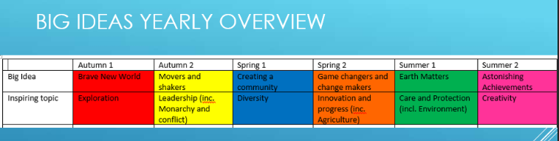
Big Ideas!

Slide 12
Brave New World
The ideas we will be exploring in Year 1 this half term are:
Imagine if… we could travel the world (vehicles).
We will learn about Christopher Columbus and the Montgolfier brothers, the countries they explored and the vehicles they used.
We will design and build our own vehicles for exploring the world.
Imagine if…we could investigate the groups of animals who live in our world.
We will learn about the 5 different groups of vertebrates and their diets. We will also explore the habitats they live in by learning about continents and oceans.

Slide 13
Learning in Year 1
English, Maths and Phonics
Independent Learning time
Handwriting
Guided Reading
PSHE (Jigsaw)
RE
PE – Tuesday / Thursday
Art
Design and Technology
Computing
Music
Forest school

Slide 14
Continuous Provision
We are introducing continuous provision to Year 1 this year.
This means that our classrooms are zoned and that there will be resources provided in each area for children to interact with creatively.
This continuous provision enables children to return to their explorations and consolidate their learning, after whole class inputs, over the course of a day and week.
It also allows children to make choices and initiate play without interaction with an adult.
Purple challenges link to new learning for the week. Children must complete these challenges by the end of the week.

Slide 15

READING
Please can we request that all children are encouraged to read at home for at least 10 minutes daily.
Please can we ask that when reading at home with your child you:
talk to your child about reading, their preferences and interests;
discuss ideas and opinions about books they are reading, ask them to summarise stories, predict, explain characters, etc;
record what they have read in their Reading Record on a daily basis.
Please ensure your child has their reading diary and book at school every day.

Slide 16
Our focus on reading…
Research shows the effects of reading on children’s later literacy skills, facilitating social interaction between adults and children, and encouraging children to engage with the world around them. It also states how reading can be a ‘stable source of information’ throughout a child’s life. This stability allows them to access text in a constant fashion and can be especially beneficial for children growing up in challenging circumstances.

Slide 17
READING
Children who are on Lilac, Pink, Red and Yellow book bands, should read each book through at least 3 times.
This is to help with decoding, fluency and expression when reading.
Books will be changed at class teachers’ discretion.

Slide 18
Homework
Homework will be set on Google Classroom on a Friday. Year 1 are being set up with log ins and we will notify you when these are ready.
Homework will be focused only on reading this year. This is in addition to reading books. Specific texts will be sent home weekly – for some pupils, this will only be to explore the vocabulary, with specific teaching in school that will be related to the learning in class. We want our children to experience a broad range of rich and diverse texts and this will be one way to encourage this love of words and reading.

Slide 19
Behaviour
Last year, we spent time considering our values, rules and expectations.
Following input from staff and children, we now have three new rules for the whole school:
Notes:
Our approach to behaviour management is focused on being positive and having high expectations of children.
We encourage children to reflect on their behaviours and make good choices.

Slide 20
PTFA
*We have a wonderful, active PTFA who have raised a considerable amount of money for our school- most notably funding our Make it Bake it room, FS1 outdoor learning area and our amazing KS2 adventure climbing area.
*They are always looking for willing volunteers to support them or run events.
*On 21st September at 8:00pm there is the AGM – This will be in Beech class at the Juniors.
This meeting roles will be agreed – please do get involved.
johnrankinptfa@gmail.com

Slide 21
Thank you for attending this evening.
Parents evenings will be coming up later this term for more specific conversations about your child’s learning.
In the meantime, if you have any questions please don’t hesitate to contact the school office and these will be forwarded to us.
We look forward to working in partnership with you and your children this year.

