Slide 1
Lower Key Stage 2 Welcome Session

Slide 2
Who’s Who!
Ms Cooper – Executive Headteacher
Miss Stephenson and Miss Amin – Deputy Headteachers
Miss Demeza – SENDCo
Mrs Tohux – Upper Junior Phase Leader
Mrs McGall – Lower Junior Phase Leader
Miss Walley – Fs2 and KS1 Phase Leader

Slide 3
Who’s Who?
Year 3 teachers –
Beech:
Miss Bradley (Mon – Weds)
Mrs Kronk (Thurs – Fri)
Oak:
Mrs Blake (Mon – Weds)
Mrs Doran (Weds – Fri)
Willow:
Mrs McGall (Mon-Thurs)
Mrs Atkins (Fri)

Slide 4
Who’s Who?
Year 4 teachers –
Ash
Miss Astbury
Chestnut
Mrs Evans
Sycamore
Mrs MacDonald

Slide 5
Inclusion and Pastoral Team
Miss Demeza – SENDCo and Inclusion Lead
Mrs Kirk – Family, Pastoral and Mental Health Lead
Miss Challis – SENDCo assistant and Speech and Language Specialist
Mrs Hawkins – Senior Mental Health Lead
Mrs Jezzard - ELSA
Miss Jutte - ELSA
Mrs Brown – ELSA
If you need any support please contact Miss Demeza or Mrs Kirk. This can be done via the office.

Slide 6
Our Office
We have one office site for our Federation, based at JRI.
Please contact the office with queries. Emails can be sent to the office to be forwarded to class teachers.
There are members of classroom staff on the Year 3 and Year 4 doors in the morning and at the end of the day if you have a question or message.
All children who are ill during the day and need to be sent home should be picked up from the infant site.
There is only one phone number for both schools and one email address should you need to contact us. 01635 42376
office@jrs.w-berks.sch.uk
If you are on Facebook, add our John Rankin page for updates.

Slide 7
General Organisation
We ask that children wear their PE kit to school on two days each week:
Tuesday and Thursday are Year 3 PE kit days
Wednesday and Friday are Year 4 PE kit days
If children are doing a Procision club after school they should come to school in school uniform and bring their kit to change into at the end of the school day.

Slide 8
General Organisation
Water bottles – Water bottles should be named and in school daily (not inside their book bag). The bottles can be refilled at school if needed. Water bottles must be spill proof and actual reusable water bottles. They must only contain water please.
Lunches – please order these in advance electronically.
Concentration aids – If your child requires a concentration aid, please communicate this with the inclusion and pastoral team. Please don’t supply these from home.

Slide 9
General Organisation
Children have the opportunity to earn a pen licence by demonstrating great effort in improving their handwriting.
This entitles them to write in pen in their exercise books, should they wish to do so.
Notes:
When they receive their licence, please provide your child with their own pen, preferably in black ink. Any style of pen that the child feels comfortable writing with is acceptable as long as appropriate for school use.
If desired, students may also provide purple pens for editing and feedback purposes.
Pens should be stored in a small, clear, and named pencil case.
No other stationary items need to be provided or brought into school. The school will provide pens for those that cannot provide their own.

Slide 10
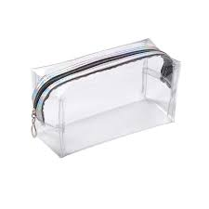
Pencil cases

Slide 11
General Organisation
Drop off and pick up
Gates open at 8:30 am
Classroom doors open at 8:35 am – 8:50am
Please exit the playground via the one-way system
Children arriving after 8:50 am should enter school via the infant office
Any children arriving at 9am or after will be marked as late

Slide 12
General Organisation
Drop off and pick up
Home time is at 3:15pm
Gates will be open from 3:10pm
Children will be dismissed from their external doors at 3.15pm

Slide 13
Walking to School
Please walk or cycle to school where at all possible.
Parking further out and walking in also helps.

Slide 14
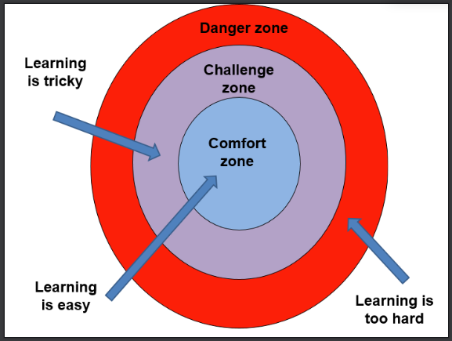
Purple Learners

Slide 15
Big Ideas!

Slide 16
Brave New World
YEAR 4 “Imagine if… we could travel to other worlds”
Ancient Greece – gods & goddesses
Judaism – the foundations of the religion
Future power sources & electricity
Creating a new world (art)
“Imagine if… we could protect our planet”
Countryside learning (Farleigh Wallop)
Living things & habitats
Environmental conservation & the Greenham Common protests
Notes:
Add detail here for your year group curriculum info for this term

Slide 17
Brave New World
YEAR 3
Imagine if... we travelled back to the Stone Age
Science – rocks, fossils and how soil is formed
Art – cave paintings
History – How people lived in the Stone Age, hunter/gatherers
DT – creating Stone Age tools
Notes:
Add detail here for your year group curriculum info for this term

Slide 18
READING
We request that all children are encouraged to read at home for at least 10 minutes daily.
Please can we ask that when reading at home with your child you:
talk to your child about reading, their preferences and interests;
discuss ideas and opinions about books they are reading, ask them to summarise stories, predict, explain characters, etc;
record what they have read in their Reading Record on a daily basis.
Please ensure your child has their reading diary at school every day. Books are changed at class teachers’ discretion.

Slide 19
Homework
Homework will be set on Google Classroom on a Friday.
Homework will be focused only on reading this year. There will be other optional learning available for all pupils, but the key focus will be on specific texts that are sent home weekly – for some pupils, this will only be to explore the vocabulary, with specific teaching in school that will be related to the learning in class. We want our children to experience a broad range of rich and diverse texts and this will be one way to encourage this love of words and reading.

Slide 20
PTFA
*We have a wonderful, active PTFA who have raised a considerable amount of money for our school- most notably funding our Make it Bake it room, FS1 outdoor learning area and soon to come, an amazing KS2 adventure climbing area.
*They are always looking for willing volunteers to support them or run events.
*On 3rd October at 8:00pm there is the AGM- at this meeting roles will be agreed – please do get involved.
johnrankinptfa@gmail.com

Slide 21
Thank you for attending this evening.
You will now have the chance to visit your child’s classroom for a general look and chat with the teacher. Parents evenings will be coming up later this term for more specific conversations about your child’s learning.
In the meantime, if you have any questions please don’t hesitate to contact the school office and these will be forwarded to us.
We look forward to working in partnership with you and your children this year.

