Slide 1

Welcome to FS2
Miss Walley, Miss Knape,
Mrs Hogg

Slide 2
Who’s Who!
Ms Cooper – Executive Headteacher
Miss Stephenson and Miss Amin – Deputy Headteachers
Miss Demeza – SENDCo
Mrs Tohux – Upper Junior Phase Leader
Mrs McGall – Lower Junior Phase Leader
Miss Walley – Fs2 and KS1 Phase Leader

Slide 3
Inclusion and Pastoral Team
Miss Demeza – SENDCo and Inclusion Lead
Mrs Kirk – Family, Pastoral and Mental Health Lead
Miss Challis – SENDCo assistant and Speech and Language Specialist
Mrs Hawkins – Senior Mental Health Lead
Mrs Jezzard - ELSA
Miss Jutte - ELSA
Mrs Brown – ELSA
If you need any support please contact Miss Demeza or Mrs Kirk. This can be done via the office.

Slide 4
Our Office
We have one office site for our Federation, based at JRI.
Please contact the office with queries. Emails can be sent to the office to be forwarded to class teachers.
There are members of classroom staff on the door in the morning and at the end of the day if you have a question or message.
All children who are ill during the day and need to be sent home should be picked up from the infant site.
There is only one phone number for both schools and one email address should you need to contact us. 01635 42376
office@jrs.w-berks.sch.uk
If you are on Facebook or Instagram, add our John Rankin page for updates.
Notes:
It will really help if you could ensure all messages are given to teachers/the office first thing/end of day and if children come to school with the right equipment.

Slide 5
General Organisation
A spare change of clothes to remain in school.
Reading books and records need to come into school weekly (Wednesdays). Do come in and ask if you have any questions.
Water bottles should also be named and in school daily (not inside their book bag). The bottles will be refilled at school if needed. Water bottles must be spill proof and actual water bottles. They must only contain water please.
PE day is Friday – children to come to school in their PE kits.
If children are doing a Procision club after school they should come to school in school uniform and bring their kit to change into at the end of the school day.
Lunches to be ordered in advance electronically.
Concentration aid – If your child requires a concentration aid, please communicate this with the inclusion and pastoral team. Please don’t supply these from home as they could get lost or broken.

Slide 6

Getting to School
Please arrive to school on time - gates open at 8.35am and close at 8.50am. The gates will be locked at this time and you must then take your child to the office to be signed in.
“Unoffical One Way” – Please exit via the top playground. This prevents congestions and people getting hurt.
Walk if you can!

Slide 7
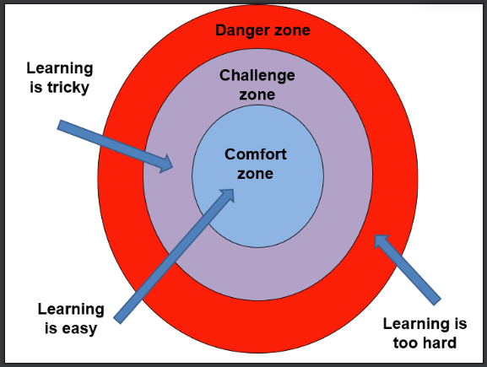

Purple Learners

Slide 8
Learning in FS2
English, Maths and Phonics
Discovery Time (Learning through play)
Handwriting
Guided Reading
PSHE (Jigsaw)
Individual Reading
PE – Friday
Creative skills
Music
Forest school
EYFS framework March_2021

Slide 9
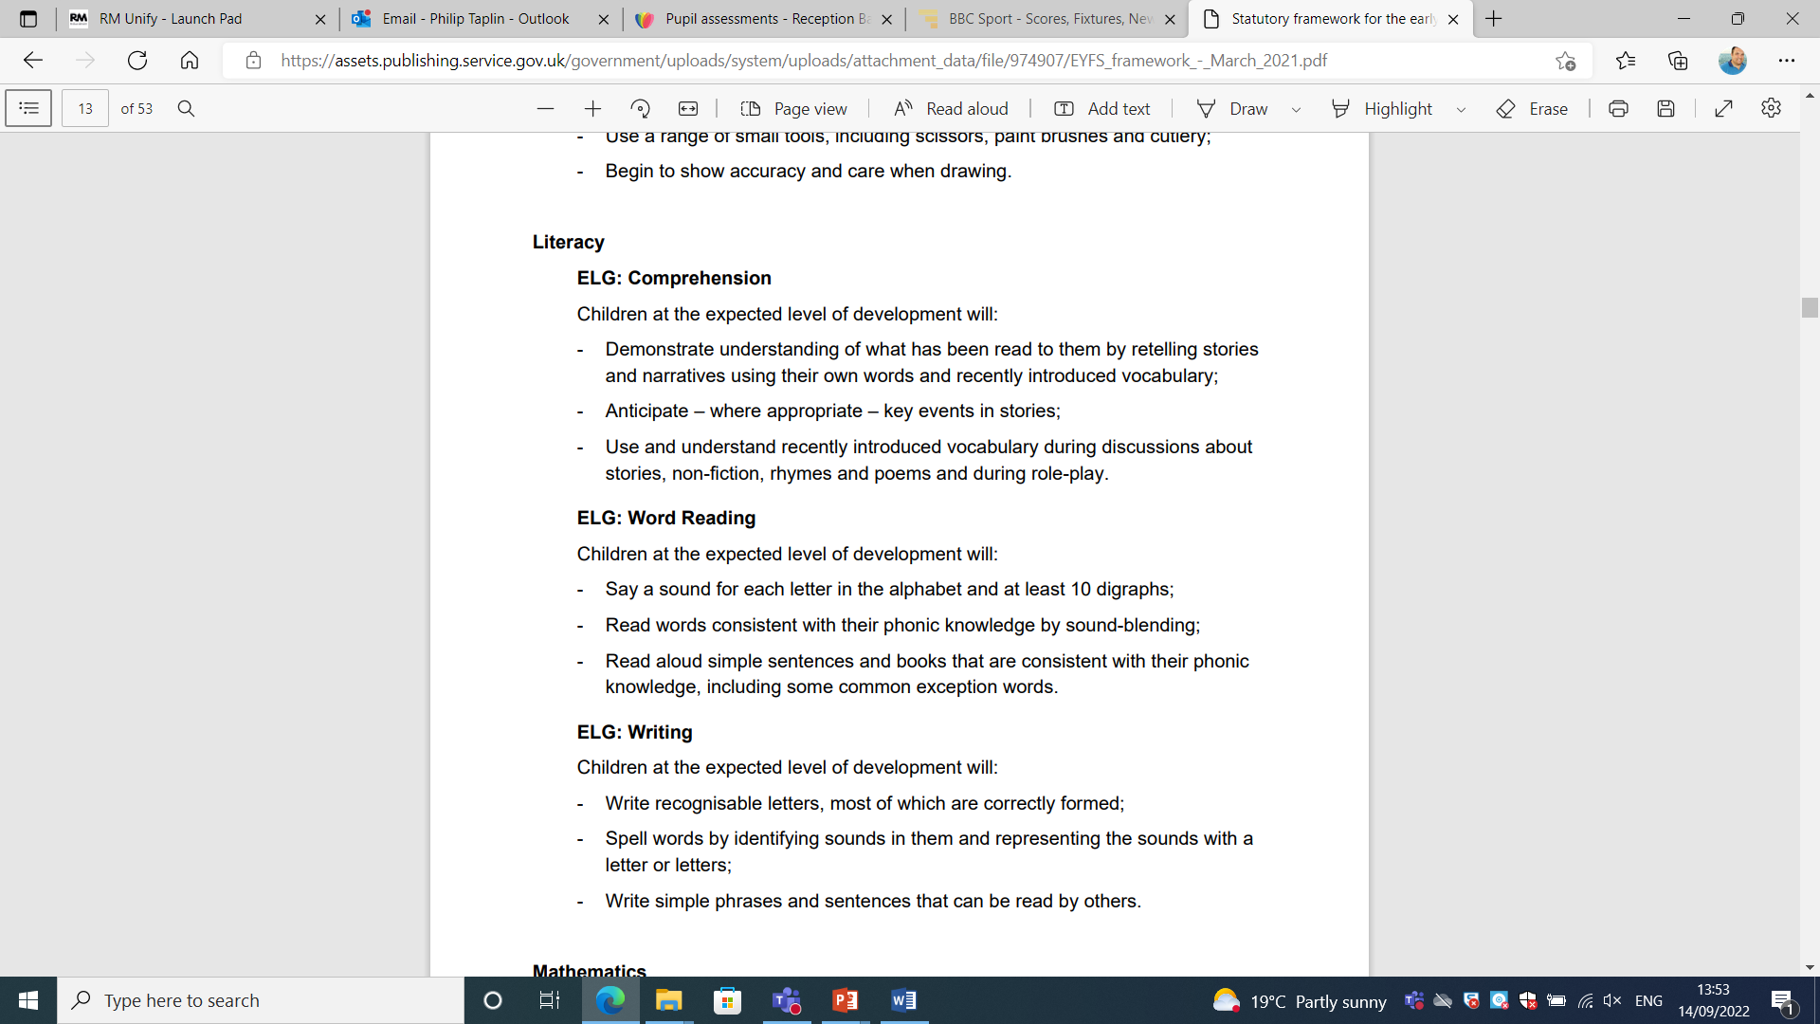
Reading

Slide 10
Reading – FS2
Children will come home with a reading book. They will be told which colour book they are on. These books will be sent home on a Friday.
Please bring them back in on a Wednesday and a new one will be sent out on the following Friday.
Lilac books have no words – these books are used at the start before children are able to read. The children will tell the story through the pictures – encourage your child to use as much detail as possible.

Slide 11

READING
Please can we request that all children are encouraged to read at home for at least 10 minutes daily.
Please can we ask that when reading at home with your child you:
talk to your child about reading, their preferences and interests;
discuss ideas and opinions about books they are reading, ask them to summarise stories, predict, explain characters, etc;
record what they have read in their Reading Record on a daily basis.

Slide 12
Our focus on reading…
Research shows the effects of reading on later literacy skills, facilitating social interaction between adults and children, and encouraging children to engage with the world around them. It also states how reading can be a ‘stable source of information’ throughout a child’s life. This stability allows them to access text in a constant fashion and can be especially beneficial for children growing up in challenging circumstances.

Slide 13
Writing

Slide 14
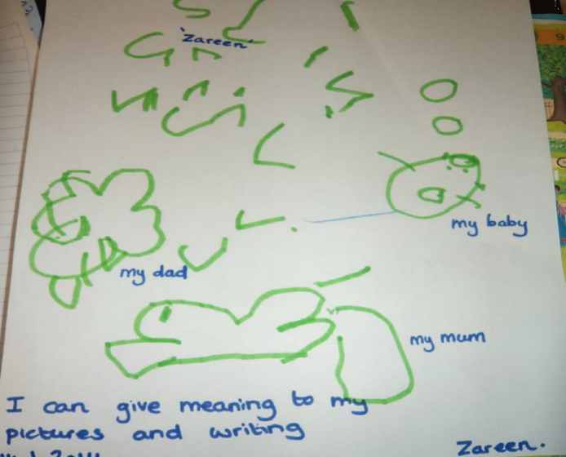
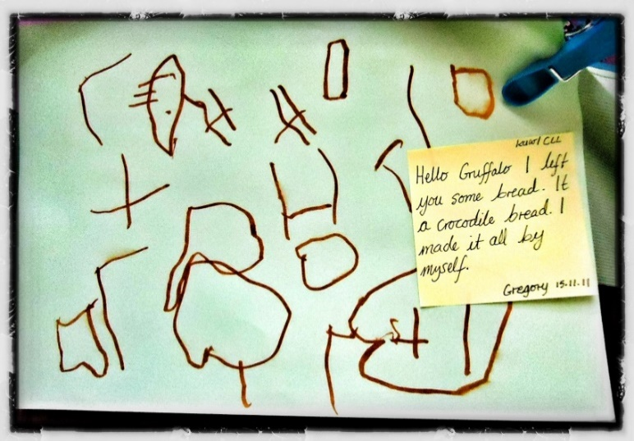

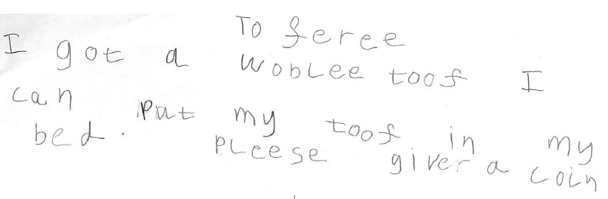
Writing
Minimum!

Slide 15
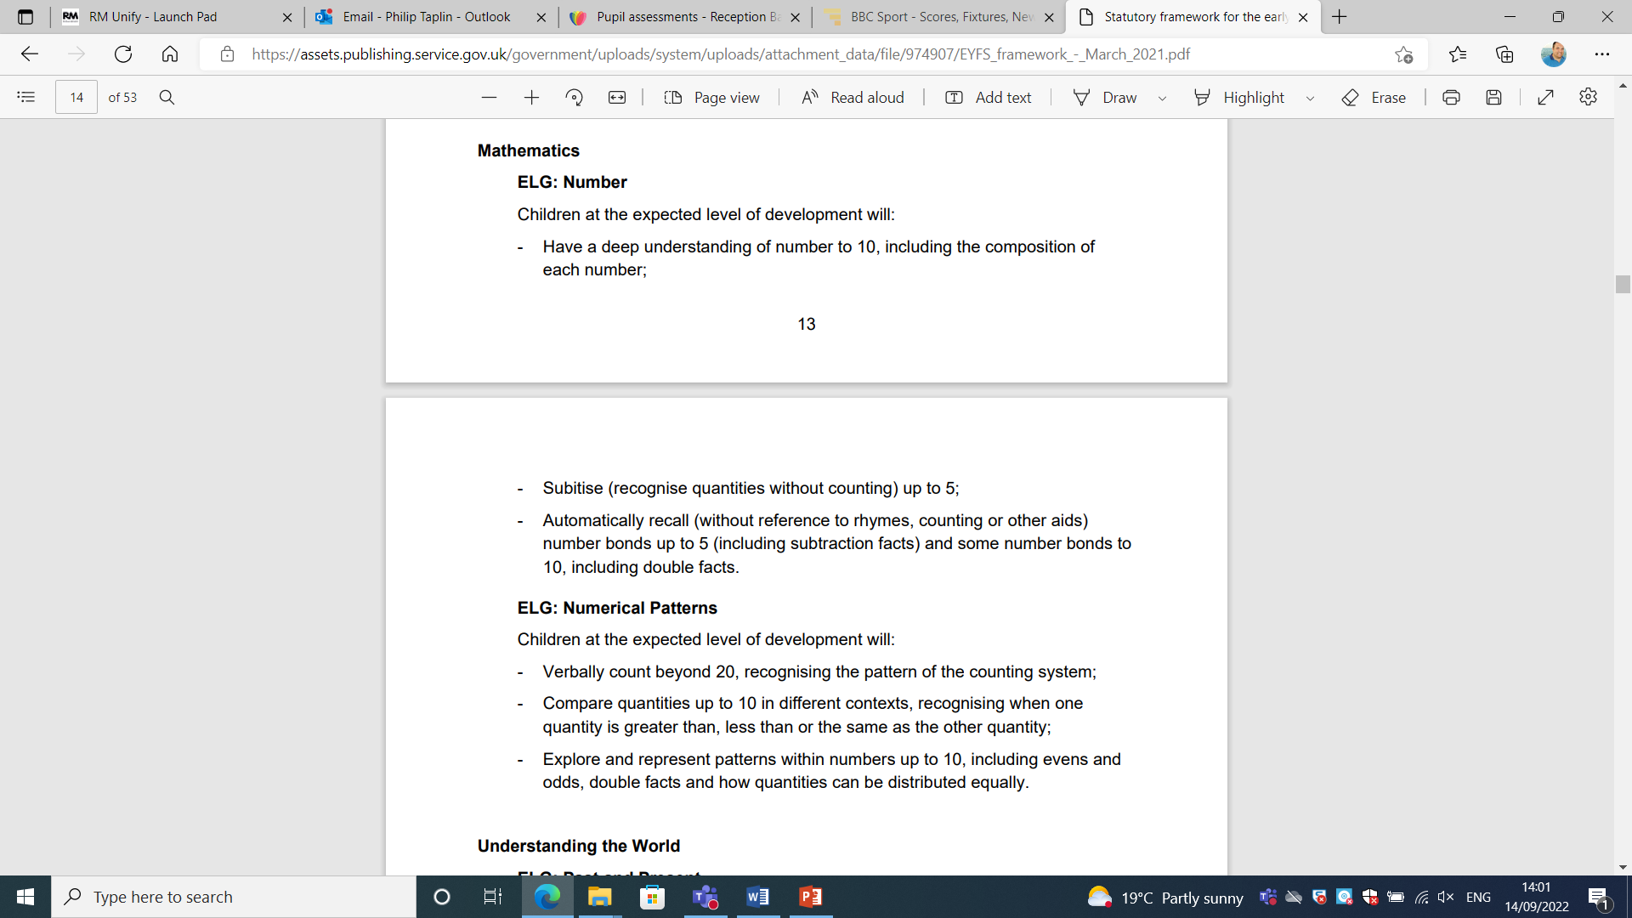
Maths - Number

Slide 16
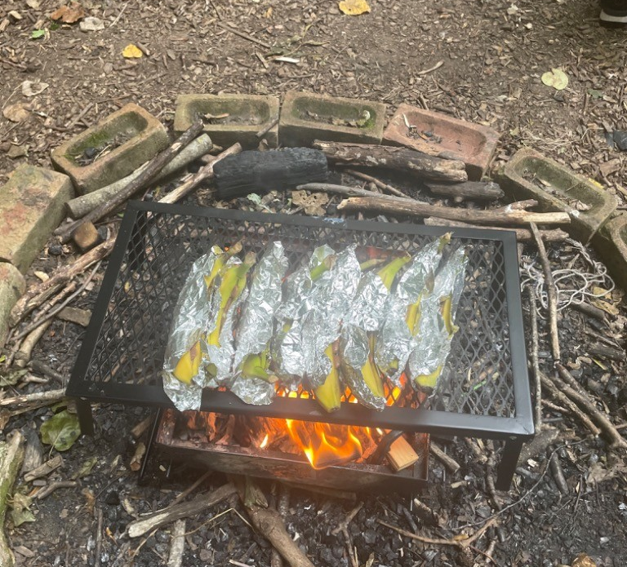
Forest School /
Wonderful Wednesday
Updates and information for Forest School is communicated via Tapestry
Children get to know all FS2 Teachers
Wednesdays – Every Week
We aim to do a cooking session every half term
Please expect MUD!
We will send waterproofs home in half terms for washing, unless needed before…

Slide 17
JRS Curriculum
Our curriculum is being developed this year to ensure the children across the school receive exciting and engaging learning. National curriculum requirements will be fully covered but we working on a JRS curriculum which does what our vision says: Ignite passion, empower learners and transform futures.
You will find details of what your children are learning each half term via medium term plans on the school website.

Slide 18
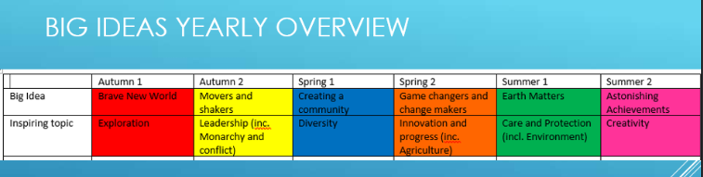
Big Ideas!

Slide 19
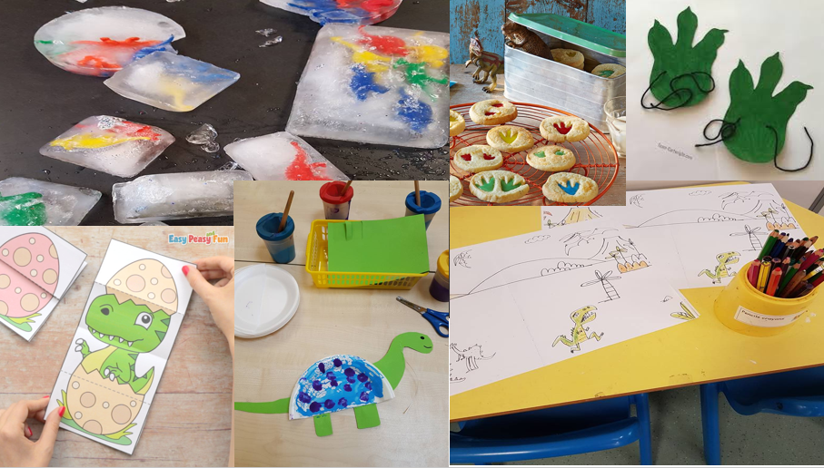
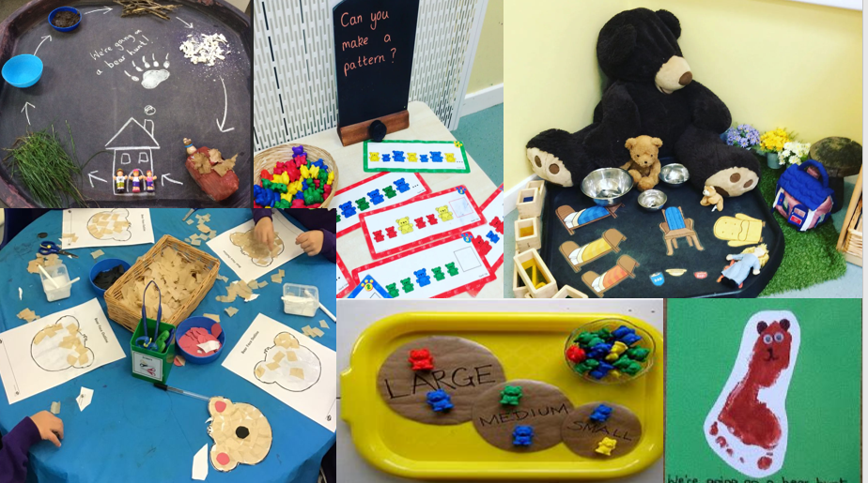
Brave New World
The questions we will be exploring this term are –
Imagine if…
Dinosaurs still exist…
You could design your own world…

Slide 20
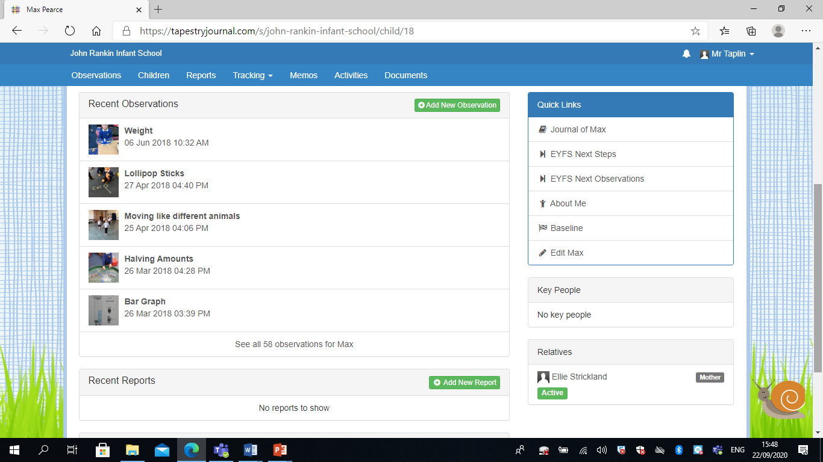
Tapestry

Slide 21
Behaviour
Last year, we spent time considering our values, rules and expectations.
Following input from staff and children, we now have three new rules for the whole school:
Notes:
Our approach to behaviour management is focused on being positive and having high expectations of children.
We encourage children to reflect on their behaviours and make good choices.

Slide 22
PTFA
*We have a wonderful, active PTFA who have raised a considerable amount of money for our school- most notably funding our Make it Bake it room, FS1 outdoor learning area and our amazing KS2 adventure climbing area.
*They are always looking for willing volunteers to support them or run events.
*On 21st September at 8:00pm there is the AGM – This will be in Beech class at the Juniors.
This meeting roles will be agreed – please do get involved.
johnrankinptfa@gmail.com

Slide 23

Thank you for attending tonight.
We look forward to working in partnership with you and your children this year.

