Slide 1
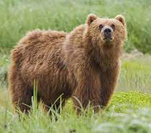
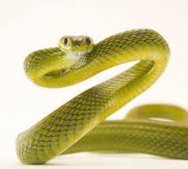
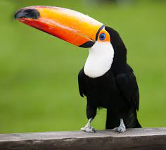
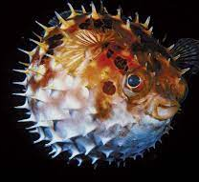
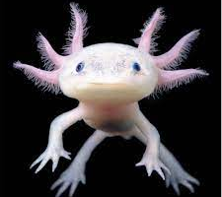
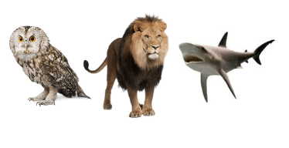
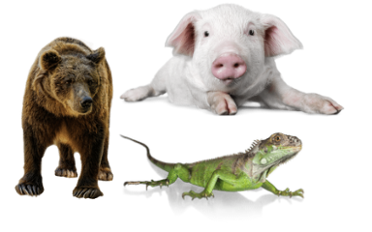
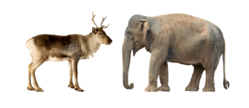
Y1: Thinking like a
scientist
Imagine if… we could investigate different groups of animals
Mammals | Reptiles | Birds | Fish | Amphibians
Mammals are warm-blooded. Most have hair or fur. They give birth to live young that are fed with milk. Cannot breathe underwater. | Reptiles are cold blooded They lay eggs. They have dry, scaly skin. Cannot breathe underwater. | Birds are warm-blooded. They lay eggs. They often have feathers to keep them warm. They have wings and hollow bones to help them fly. They have beaks. | Fish are cold blooded. They live in water. They lay eggs in water. They have fins and scales. Can breathe under water using gills. | Amphibians are cold blooded. They live in water and land. They lay eggs. They have 3 life stages: egg, larvae and adult. Can breathe underwater using gills
human monkey lion dolphin cat | lizard crocodile snake | robin penguin ostrich chicken owl | shark salmon ray tuna goldfish | frog toad salamander newt axolotl
Vocabulary
fur | The hairy coat of a mammal
scales | Small plates that protect the skin
feathers | Cover the body of a bird
wing | Allows some birds to fly or swim
gills | Allows fish to breathe underwater
fin | Helps fish to swim and balance
beak | The nose an mouth of a bird
Warm-blooded | Body can regulate its temperature
Cold-blooded | Body temperature changes to its surroundings.
eggs | A round object laid by birds, reptiles, fish and amphibians
Carnivore Animal that eat meat and other animals (including insects) |  | Omnivore Animal that eats both plants and other animals |  | Herbivore Animal that only eats plants

