Slide 1
Theory of Mind and Empathy
Autism Team

Slide 2
Processing and learning
Notes:
Processing information can mean many different things. Reminder that every autistic child is different

Slide 3
Processing information differently can include…
Processing everything (⇨distraction & overload)
Logical, often serial processing (can be monotropic)
Black and white thinking
An ability to hyperfocus,
What appear to be difficulties with executive functioning (e.g. sequences, processing time, organising self)
Strong attention to detail but less to the whole picture (weak central coherence)
Difficulties processing non autistic emotions and beliefs
Notes:
Next slides focus on the last 2

Slide 4
Impact of anxiety on processing information..
We need to be aware that high anxiety increases this way of thinking:
Serial processing, can be monotropic (tunnel vision)
Black and white thinking
Difficulties processing other people’s emotions and beliefs
Notes:
High anxiety (in anyone, autistic or not) causes an increase in monotropic thinking (‘tunnel vision’), back and white thinking and difficulties in executive functioning….
Next slides focus on the last 2

Slide 5
Processing everything means…
Harder to stay on task
Harder to distinguish key information from trivial
Hard not to become overloaded and exhausted
Can see all sorts of information/detail others do not!
Notes:
Not a choice!
Distraction
Makes it difficult to see key information, to make a choice, stay on task

Slide 6
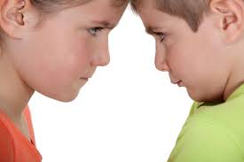
Difficulties understanding others…
Difficulties in instinctively ‘guessing’ or ‘just knowing’ what a (non autistic) child or adult believes, wants or intends (for example)
Notes:
Unclear now whether or not this is theory of mind
This can make other pupils –and adults – seem unpredictable and confusing.

Slide 7
Difficulties understanding others…
In a class full of non-autistic peers and staff, and autistic young person can worry:
What are others thinking of me? (I literally can’t guess)
What is he/she going to do next? (‘I absolutely do not have a clue and that makes me nervous’)
Are they laughing at me? (‘I literally don’t know’)
Why are you taking the pens? (you must know I want them)
Why are you angry that I have taken the pens ? (you must have known I want them)
Notes:
Cover ruminating on social situations. It can be little help to say ‘I am sure they weren’t laughing at you’ because an autistic child may think ‘how could you possibly know they weren’t laughing at me’ (I have no idea how you would know that!).

Slide 8
Theory of mind?
Theory of mind is said to be the ability to understand the desires, intentions and beliefs of others, and a skill that develops between 3 and 5 years of age in typically developing children.
Notes:
1985, Baron-Cohen, Frith and Alan Leslie conducted studies with autistic children and concluded this ability to be lacking in autistic children.
Now some debate about this!

Slide 9
…or double empathy problem?
“Simply put, the theory of the double empathy problem suggests that when people with very different experiences of the world interact with one another, they will struggle to empathise with each other.”
Damian Milton
Autistic children may find it difficult to understand the beliefs, desires, needs of the non autistic peers but equally, their non autistic peers may find it difficult to understand them.
In other words, they problem is on both sides.

Slide 10
Communicating and socialising differently

Slide 11
Communicating differently
Differences in:
Receptive language
Expressive language
Use and interpretation of facial expressions
When and how often eye contact is made
Use and interpretation of body language
Use (or not) of intonation
Notes:
Will look at this in more detail below, but briefly

Slide 12
Communication chain
Notes:
May be differences at any part of this chain – potential for misunderstanding on either side enormous

Slide 13
Processing communication
Some autistic pupils will do this differently, e.g.
Processing every single word in detail
Processing literally (when others do not speak literally)
Processing words when you think in images
Notes:
May be differences at any part of this chain – potential for misunderstanding on either side enormous

Slide 14
How many questions can you answer?
Notes:
Compare to learning in class
https://www.youtube.com/watch?v=9bC5Daif__8

Slide 15
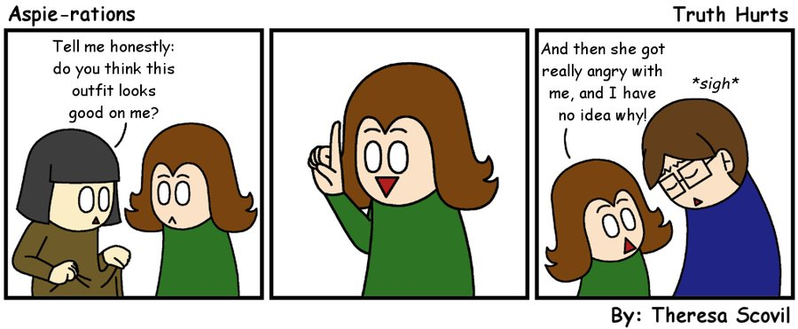
Processing the social world differently

Slide 16
Processing the social world differently
The subtle science of social rules…
When is bluntness OK?
Making and keeping friends
Play – how to play and what to play
Saying hello and saying goodbye
Rumination and social hangovers
The research
Notes:
Will look at this in more detail below

Slide 17
Social Stories can ;
give individuals some perspective on the
thoughts, emotions and behaviours of others,
personalise social skills for an individual,
break down goals into achievable steps,
teach routines,
describe possible responses to actions,
translate observed behaviours into social understanding
address a wide variety of behaviours, including obsessions and compulsions.

Slide 18
Comic strip conversations:
Idea of Carol Gray – theory of mind and social understanding
Conversation and visually based walk through of real life situations
You draw as you talk to show the perspectives of each person in an interaction
You start with their perspective
Then add a second layer
Each stage is a contrasting colour

Slide 19
Comic strips are useful for:
Deception
Ridicule
Conflict resolution
Communicating feelings
Allows processing time
Can reduces stress
KEEP STRIPS, REFER BACK TO
You can also use them to draw out a pupil’s explanation for their behaviour in a specific situation

Slide 20
https://www.youtube.com/watch?v=Mnf4K38JwpU
Purple Ella Clip link above

