Slide 1
Pre-teaching for Independent Learners

Slide 2
Pre-teaching is the teaching of the language or concept
learners need before an activity.
Example The learners are going to hear a short discussion on environmental issues. Before listening, they match key environment words to definitions.
In order to pre-teach vocabulary effectively, the teacher needs to identify what the learners already know and what might cause problems. Although course books often provide this information in pre-teaching stages, many teachers take time when planning to identify problem areas.

Slide 3
Pre-listening activities are things learners do before a
listening activity in order to prepare for listening.
These activities have various purposes, including pre-teaching or activating vocabulary, predicting content, generating interest and checking understanding of task.
Example The learners are going to listen to a radio programme about sharks. First, they work in groups to pool their knowledge of sharks and then tell the rest of the class.
In the classroom Pre-listening tasks include discussion questions, true or false statements, vocabulary work, prediction tasks and brainstorming the topic.

Slide 4
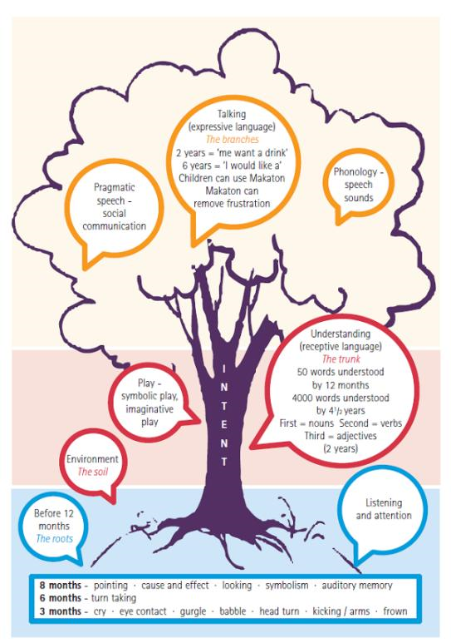
Stages of Speech and Language
Communication Tree

Slide 5
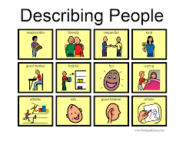
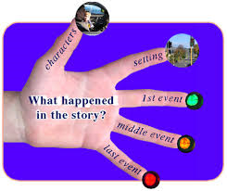
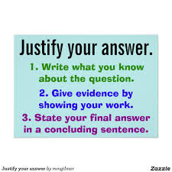
Blank Levels
Blank Level1 – Naming
Blank Level 2 – Describing
Blank Level 3 – Re-telling
Blank Level 4 - Justifying

Slide 6
How do we aid receptive vocabulary?
‘Having heard a new word and stored what it sounds like, we need to find out what it means. We pick up meaning from hearing a word many times in context.’
‘Words mean more with visual
representations. This helps the brain
store the word and it’s meaning and
context.’

Slide 7
Basic principles
Children experience the vocabulary by an adult talking through each image first
They then begin by syllable clapping with the adult and repeating – once embedded this activity can be used independently by the child and support the application of some aspects of phonics
They practise using the games – at this stage they should be asked to put the vocabulary into sentences
Application then occurs by accessing classroom learning and using the vocabulary in conversation and in reading, writing and researching.

Slide 8
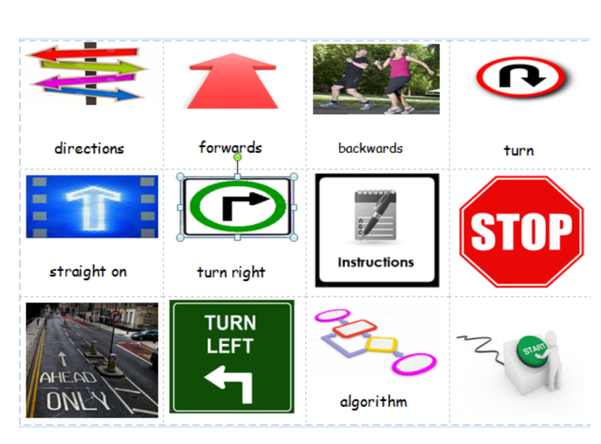
Word mats
These are the basic tools for
topic vocabulary
They should be;
visual and engaging
Accessible in class and at home
Used as the basis for all the pre-teaching games and in pre-reading sessions

Slide 9
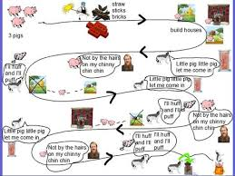
Pre-reading texts
What could you do?
Read a section or all of the story
Ask questions based on the characters
Sequence the pictures from the story
Focus on a picture – what is happening, what are they thinking, what would they say
Spot the detail
Complete a story map

Slide 10
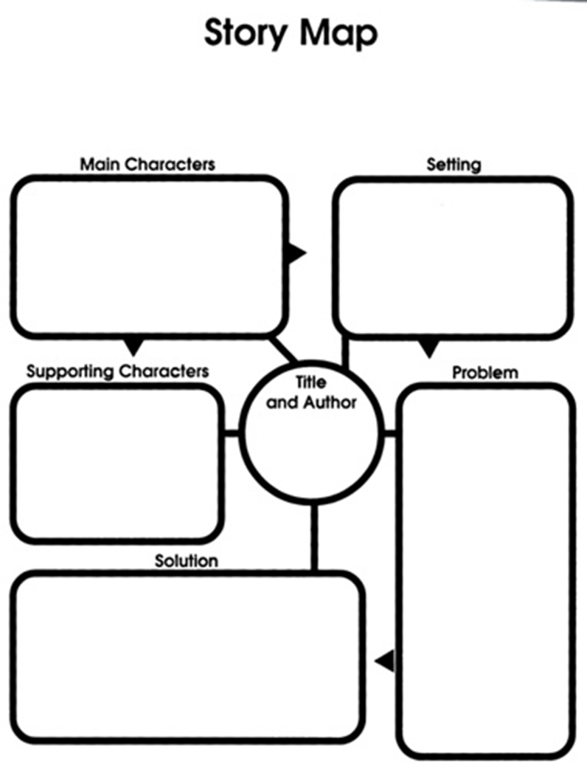

Slide 11
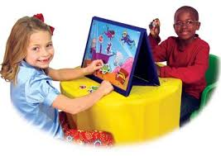
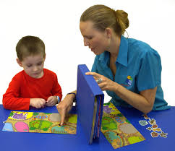
Barrier games

Slide 12
Can use a picture from a story or a scene or labelled picture
Can be done in pairs and independently of an adult

Slide 13
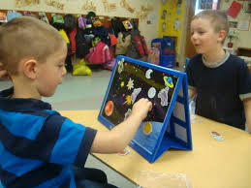
Barrier games
Could be used with objects or pictures
Is Self-correcting

Slide 14
Chatty boxes and feely bags
Name the objects
Clap the syllables
Say what it is used for…something about it…
Say a sentence with the word in
Tell a story in the group
Pick 3 objects and use them in a short story
Include other speech and language skills such as; positional language, his/her
Use with a book to reinforce a story

Slide 15
Vocabulary games
Dominoes
Snap
Spot the difference
What’s going on?
Riddles – I am…
Headbanz
4 in row or noughts and crosses
Board games
Active games
Bingo/lotto
Inquire and eliminate
Identify and describe

Slide 16
Concept/mind mapping
Notes:
Mainly a verbal game using the vocabulary

Slide 17
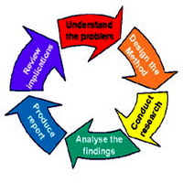
Research
Resources
Activities
Discuss relevant searches to pinpoint the right information
Highlight the topical or relevant words and make a glossary or word search
Skim and scan in pairs – pick out the main points of a text
Play the ‘Key facts’ game – take it in turns to say a fact about the topic using the vocab
Ipads
Computers
Books/Encyclopedia
Selected information
Home study
Games online
Espresso
Purple mash
wickipedia

Slide 18
see, know, question
What can you see?
What do you know?
What would you like to know?

