Slide 1
Supporting Speech, Language and Communication skills
Property of Berkshire Healthcare Foundation Trust. Do not reproduce or distribute without prior written consent.

Slide 2
The Statistics
10% of all children will have a long term and persistent communication difficulty.
In some areas of the country, 50% of children are starting school with poor speech, language and communication skills.
A child’s vocabulary at age five is a predictor of his educational success and outcomes at age 30.
60% of young people in young offender’s institutions have a communication difficulty.
50-90% of children with persistent difficulties will go on to have problems with reading.
Notes:
Talk through statistics. (3-4 minutes)

Slide 3
What elements make up communication?

Slide 4
The Communication Tree
Leaves and blossom = speech sounds
Branches = Expressive / spoken language
Trunk = Receptive language / Understanding
Environment-
too little stimulation
Environment-
too much stimulation
Attention & listening
Development of Play
Turn taking
Desire to communicate
Notes:
Adult-child Interaction is the foundation for development of all communication skills. The adult provides information about what the child hears/sees/does, and helps the child make sense of the world. They enjoy being together, and desire to understand one another. Many early communication skills are non-verbal. Above all else a child needs to become motivated to communicate.
Looking and Listening (attention) develops alongside other skills. Without this, the child will not be able to match the language he hears to what he is doing. This is the ability to be observant, then focus in things that are interesting to them, then on activities. By school, they should be able to listen while working.
Play is the way the child learns about the world around him. Children need to have a variety of experiences to help them acquire language for thinking, learning and communicating. Pretend-play is particularly important. The symbolic nature of play is linked to the development of symbolic thinking which is essential for language development. Many children with language difficulties have problems with pretend-play.
Understanding is often over-estimated by parents/carers. This is because a child can follow instructions using non-verbal understanding, e.g. facial expression, tone of voice, gestures, following cues from the situation or routine, or copying others. But they might not be able to understand verbal instructions/cues. Children need to understand a word before they can say it with true meaning.
Talking (expression) is the child’s own use of words and sentences. Before talking, the child will express himself through non-verbal communication e.g. cooing, babbling, facial expressions, pointing, gesture.
Speech Sounds = Pronunciation the “tip of the iceberg”. It is the area of language that is most conspicuous, but the foundations must be in place before this is targeted. Speech sounds also develop in stages.
The stages are inter-dependent and each stage continues to develop as the child moves up to the next level. This model helps us to see where a child is having difficulty and where we need to support or stimulate them.

Slide 5
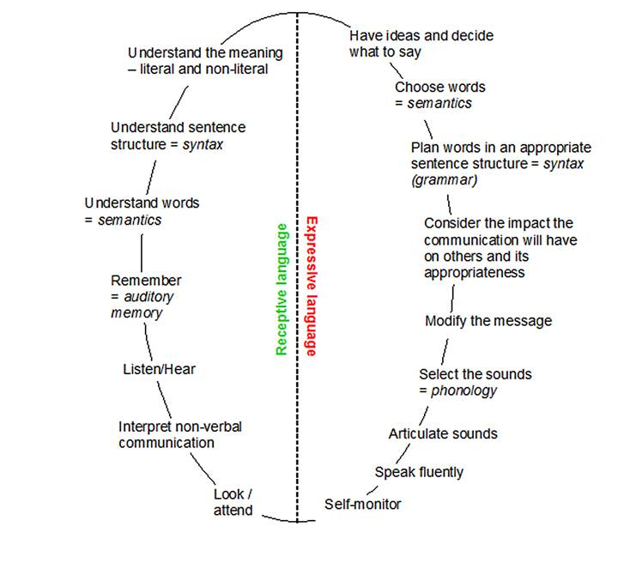
The Communication Chain
Notes:
Look/ attend- Helps to focus our attention on the speaker.
Interpret non-verbal communication- Looking at the speaker also provides information about non-verbal communication. This includes all the body movements, expressions and gestures but also ways of using our voice.; pitch, volume, intonation and clues from the situation.
Listen/ hear- The listener needs to be able to concentrate on the speaker. The listener needs to be able to focus on the right information and filter out all other information that may be distracting. Listening is a skill we have to learn. Hearing is the ability to perceive and analyse acoustic information.
Decide- Having ideas and deciding what to say. The planned response must be relevant and appropriate for the situation.
Remember- Short term memory- Stores the information heard for a brief period of time (20 seconds) while it is processed and analysed by the brain.
Long term memory- Is the store or bank of all the knowledge and individual has. The long term memory stores all our words.
Understanding words-To understand what someone is saying we need to understand the vocabulary and concepts they are using. These concepts can be abstract (e.g. ‘yesterday’) or concrete (e.g. colour concepts).
Understanding sentence structure- How those individual words fit into the sentence and impact on the meaning. For example did the speaker say ‘I’ll phone Sarah’ or ‘I phoned Sarah’.
Understanding the meaning- The intent of the speaker- what is meant rather than what is said.
Decide- Having ideas and deciding what to say. The planned response must be relevant and appropriate for the situation.
Choosing vocabulary- Being able to think of and find the correct words from the bank of words in your memory. If the words are not stored correctly it may be very difficult to retrieve the correct vocabulary. This means that a child may have an idea but is not able to fully express it.
Putting words into a sentence- It involves an ability to form grammatically correct sentences. To do this a complex knowledge of the rules of grammar is required.
Select sounds and plan how to say the words in a sentence- Alongside the meaning of each word is stored information about how to articulate or say the word. This is template of how to say the word. The template needs to be modified depending on how the word is spoken, e.g. Is it going to be stressed in a sentence? As in ‘Mr Brown would like to see you’ as opposed to ‘Mr Brown would like to see you’.
Coordinating the instructions to the speech muscles- Instructions from selecting the sounds and planning how to say them need to be sent to the muscles of the mouth, tongue and lungs.
Articulating sounds
Speaking fluently
Speak appropriately- Speak at the right time, the right was with the right content. Manage a conversation appropriately- know how to start, maintain and finish a conversation. If the conversation goes wrong know how to repair it. Use appropriate volume, speed and pitch.
Use appropriate non-verbal communication- Non-verbal communication can support what is being said (e.g. Through eye or finger pointing) or be used to conflict with the literal meaning of a phrase. The presence of such a conflict can be crucial to portraying a speaker’s intent as sarcasm.
Self monitoring- Key for language development. Children with language difficulties often have problems monitoring their own speech and subsequently give responsibility for their communication to the other person. It is a subconscious checking mechanism that continually assesses the appropriateness of the structure, content, articulation and use of language and should prompt the speaker to correct themselves as and when necessary.

Slide 6
Identification of children with SLCN
Attention & Listening
Understanding
Language
Behaviour
Impact
Social
Interaction
Use of
Language
Speech
Sounds
Vocabulary
Notes:
Examples for each area may include:
Attention and listening:
Tune in and out of the information and so only hears part of the information
Appears to switch off from what is being said to them
Becomes distracted easily- moves around the classroom. Can become disruptive.
Often asks others what they need to do.
Understanding language
Difficulty understanding new/ abstract vocabulary
Difficulty answering open ended questions such as ‘why’ and ‘how’.
Try to disguise difficulties by watching/ copying others.
Try to avoid tasks by opting out, being disruptive or using delaying tactics.
May demonstrate difficulty understanding what they have read.
Difficulty when instructions are long and there visual support is reduced.
Use of language
May struggle to form grammatically accurate sentences and this is also mirrored in their writing.
Difficulty organising and retelling stories/ events in the correct sequence. This can make their speech difficult to follow as it lacks structure.
May avoid the frustration of talking by saying ‘don’t know’, giving up or storming off.
Difficulty talking about things that are not based on the here and now.
Difficulty explain how they are feeling.
Vocabulary
Poor vocabulary knowledge. Difficulty using new/ curriculum specific vocabulary within their speech and writing.
Uses non-specific words such as ‘he was doing things’
Needs extra time to think of the word they need.
Sometimes says a word that is similar in meaning to the target word or sounds similar.
Limited range of adjectives/ descriptive language.
Speech sounds
Speech sound errors are mirrored in their phonics/ spellings.
Peers and adults find it difficult to follow what the child is saying and they need to be asked to repeat what they have said.
Can use a sound in a specific task but not consistently within their everyday speech.
Social interaction:
Have difficulties initiating a conversation with others. May talk about specific/ chose topics.
May have difficulties changing the way their communicate to suit the situation (e.g. talking with peers vs. talking to teacher.
Have difficulty asking to join in play with their peers. May often play alongside or watch and wait to be asked.
Difficulty following rules of playground games when they change suddenly.
Difficulty sorting out ‘problems’ with peers may require support from an adult.
May not understand the impact that something they have said has had on the listener.
Not able to read other people’s body language. May say something inappropriate without realising.
Behaviour
May be a very passive/ quiet member of the classroom. May not volunteer ideas unless asked.
Can be easily led by others and follows what they do.
Can become frustrated when they have not understood/ unable to effectively share their ideas. This may result in shouting, leaving the classroom, throwing items.

Slide 7
The CYPIT Speech and Language Therapy Service
Individualised
Accessed by a small number of children
e.g. 1:1 assessment
Specific demonstrations
Targeted
Some children can access this service
e.g. Modelling a vocabulary group that can be run by school staff
Universal
All children can access this service
e.g. whole school training on setting up a good communication environment
Notes:
Universal:
This service can be accessed by all children.
School can deliver training to staff within the school relating to classroom strategies.
School can advise on setting up a good communication environment within the classroom.
School can liaise and advise staff on strategies to implement within the classroom to support children with SLCN.
Support staff to identify children with SLCN.
Targeted:
This service can be accessed by some children who are following a delayed pattern of development.
School can support and model the implementation of speech and language groups to staff.
The SLT will offer advice to help staff support specific children in their day to day teaching and the therapist would not need to see the child.
Individualised:
This service is accessed by a small number of children who require specialist support to make progress.
School can complete 1:1 assessment with a child and provide report/ therapy plan.
School can demonstrate and model activities from a child’s therapy plan to a member of staff.
Attend meetings such as EHCP meetings and annual reviews relating to a specific child.

Slide 8
What do I do if I have concerns about a child’s speech and language skills?
Discuss your concerns with your SENCO.
The SENCO will ask you what ‘impact’ the child’s speech and language skills are having within the classroom.
The SENCO will ask you what is already in place to support this child.
If a referral to speech and language therapy is agreed the following forms need to be completed:
Referral form
Parental consent form that details ethnicity
Consent form to share information via email

Slide 9
Links to useful resources
CYPIT School Years Toolkit https://www.berkshirehealthcare.nhs.uk/our-services/childrens-healthcare/cypit-toolkit-the-school-years/
www.thecommunicationtrust.org.uk
www.ican.org.uk
Ralli Campaign on YouTube

