Slide 1

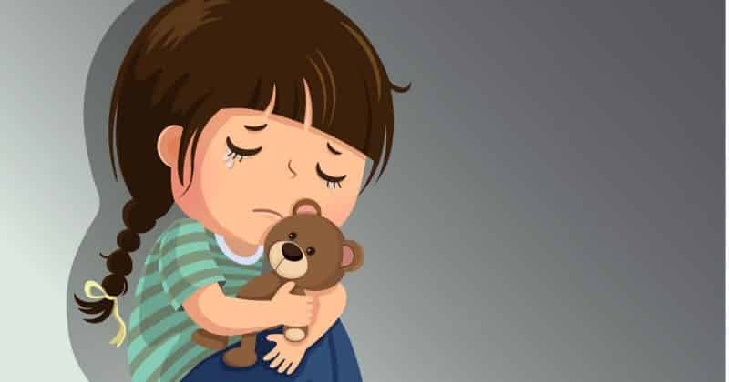
Anxiety / Stress
Understanding & Supporting Our Children
Kelly Evans
Autism Advisor for Families

Slide 2
Learning Objectives
Understanding What is Anxiety and it’s causes
Learning how to support our young people and changing our approach
Looking at a CBT approach and using some of their techniques

Slide 3

What is Anxiety
Something we all experience
“a feeling of worry, nervousness, or unease about something with an uncertain outcome:” (oxford dictionary)
It becomes a problem when it STOPS your child from enjoying normal life by affecting their school, work, family relationships, friendships or social life

Slide 4
Different Kinds of Anxiety
Separation anxiety: fearfulness re: safety of self and loved ones. Associated with avoidance of certain situations (e.g.,playdates, school) and dependence or “clinginess” to adults.
Social phobia: associated with shyness, fear of embarrassment,social reticence. Leads to social isolation & few peer friendships.
Generalised anxiety: excessive worry about daily events, past & present (e.g., homework, tests, popularity, health…). Associated with tension, irritability, aches/pains, or difficulty sleeping…

Slide 5
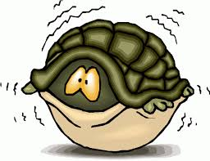
Learning to Beat Anxiety
Remember there are times when we ALL feel worried, anxious, uptight or stressed. This is NORMAL and often there is a reason.
Other times these feelings can feel so strong that they take over and my STOP us from doing the things you want to or have to do in life.
We just want to hide…
When this happens we need to take control and learn how to beat these feelings.

Slide 6
Why do children become anxious?
We do have to consider the SEND as well their own sensitivities
Often we develop anxiety following a series of stressful life events – so this can include school as well as family issues
Child anxiety
Genes
Parent anxiety
Temperament
Life events
Thinking styles
Learning experiences
Our children will pick up on our own anxieties.
Anxious people tend to expect the worst scenario will always occur. So find it hard to relax
It has also been suggested that anxiety has family ties.
When we are under threat or feel danger. It helps us with our fight & flight preparing us for a quick response

Slide 7
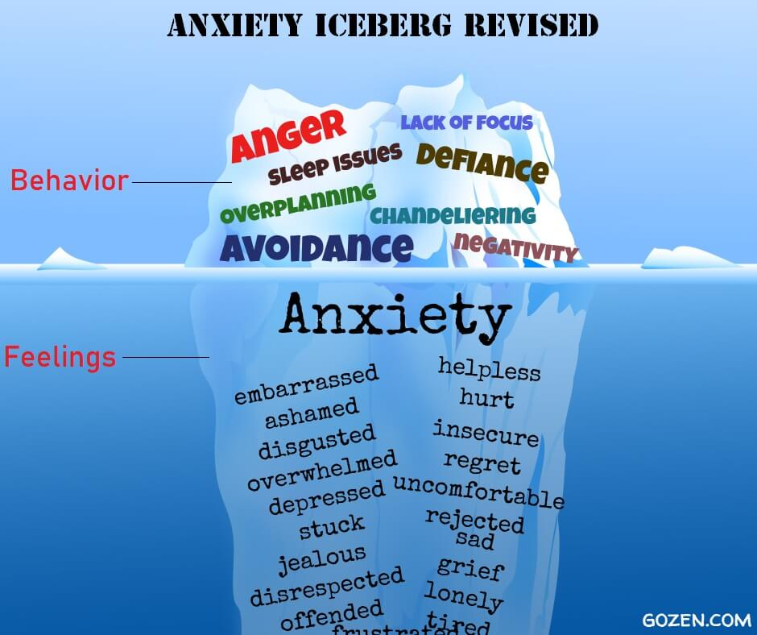
Notes:
Chandeliering when a seemingly calm person suddenly files off the handle for no reason

Slide 8
Indicators of anxiety / stress:
Sleep issues
Increased use of toilet
Eating issues
Irritability or ‘flat’
School refusal
Increase in obsessions
Repetitive questions
Change
Tummy Aches
Avoidance or refusals
Separation
Volume
controlling
Self harming
Withdrawing from social contacts/activities
Destructive behaviour /anger
Headaches / tension
Inappropriate laughter
Sensory seeking
Notes:
1.45
Kate

Slide 9
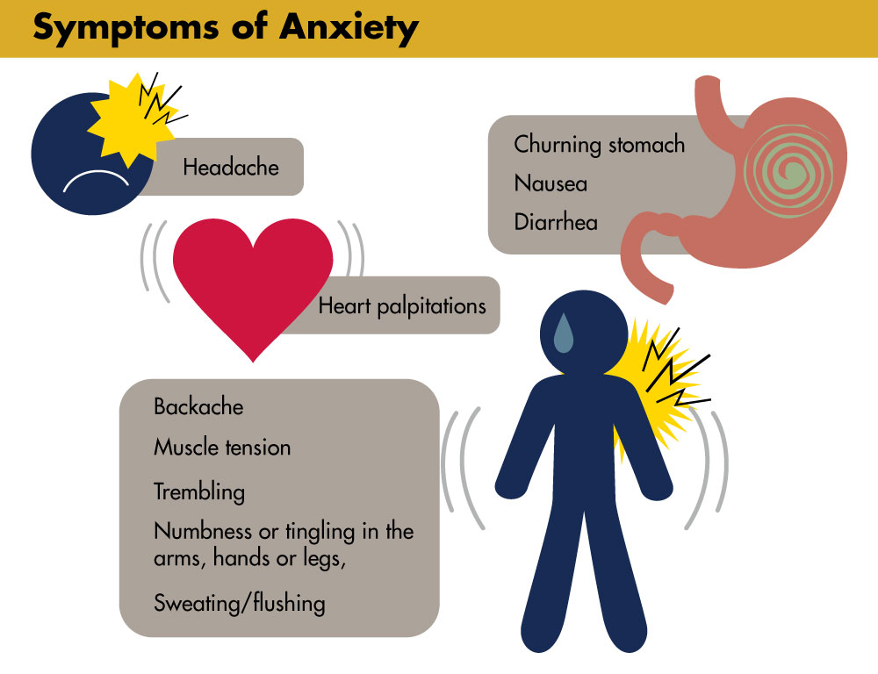

Slide 10
Connect with your child
Using a PACE - Dan Hughs
Playfulness: use a light tone, avoiding sarcasm, anger or blame in your response to a child’s behaviour
Acceptance: really take time to observe and understand the emotions of your child, and accept that these are their feelings at this moment. (whether or not you agree). Unconditional positive regard is essential.
Curiosity: really be curious and explore your child’s feelings with them, asking them open questions to try and understand what led them taking a certain perspective. Try not to assume what the child is thinking.
Empathy: understand and genuinely accept the child’s feelings in response to a situation. Feeling their feelings with them.

Slide 11
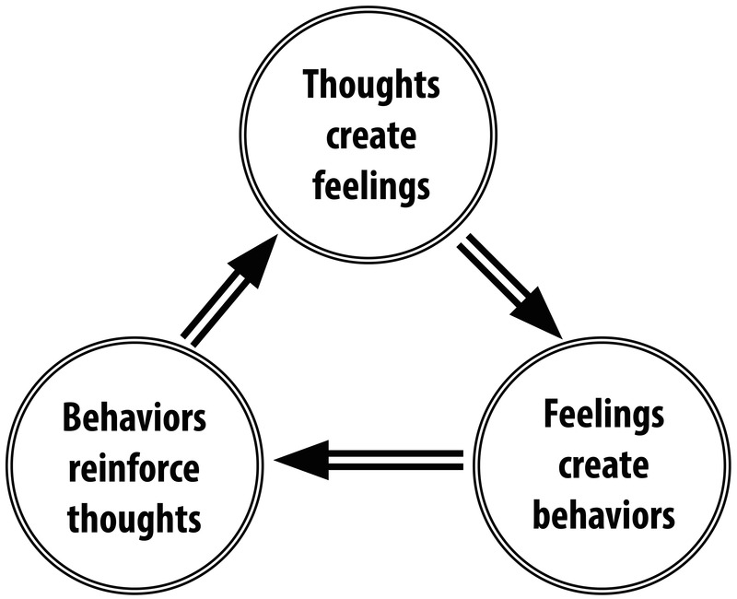
Cognitive Behaviour Therapy - CBT
Is a talking Therapy
Focuses on how your thoughts, beliefs and attitudes which can affect your feelings and behaviour, and teaches you coping skills for dealing with different problems.
Anxiety can lead us to having unhelpful thoughts, making us feel bad and then have an affect on how we deal with that and behave

Slide 12
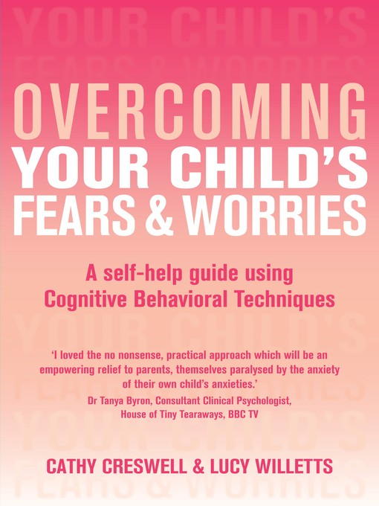
A Guide for Parents on how to deliver CBT
Addresses specific fears and phobias as well as general anxiety and 'worrying'.
Provides step-by-step practical strategies.
Includes case studies, worksheets and charts.
Encourages you to help your child problem solve for themselves
Based on the authors' experience at their anxiety disorders clinic at the University of Reading and developed from a programme based on working almost exclusively with parents.

Slide 13
5 Step Approach
This uses a Cognitive Behavioural Approach There are 5 steps
1. Learning to spot your child’s anxious thoughts
2. Helping your child to evaluate the thought and consider other points of view
3. Encouraging independence and ‘having a go’
4. Developing a step by step plan with your child
5. Problem solving

Slide 14
Step 1 – Spotting anxious thoughts
Anxious children are on the ‘look out’ for threat and ‘jump to conclusions’ and if what is going on is not absolutely clear they can interpret the situation as threatening.
It can be helpful to think of thoughts, feelings and behaviour linking up in a cycle.
What is happening? What is your child thinking? What is your child feeling? What does your child do?

Slide 15
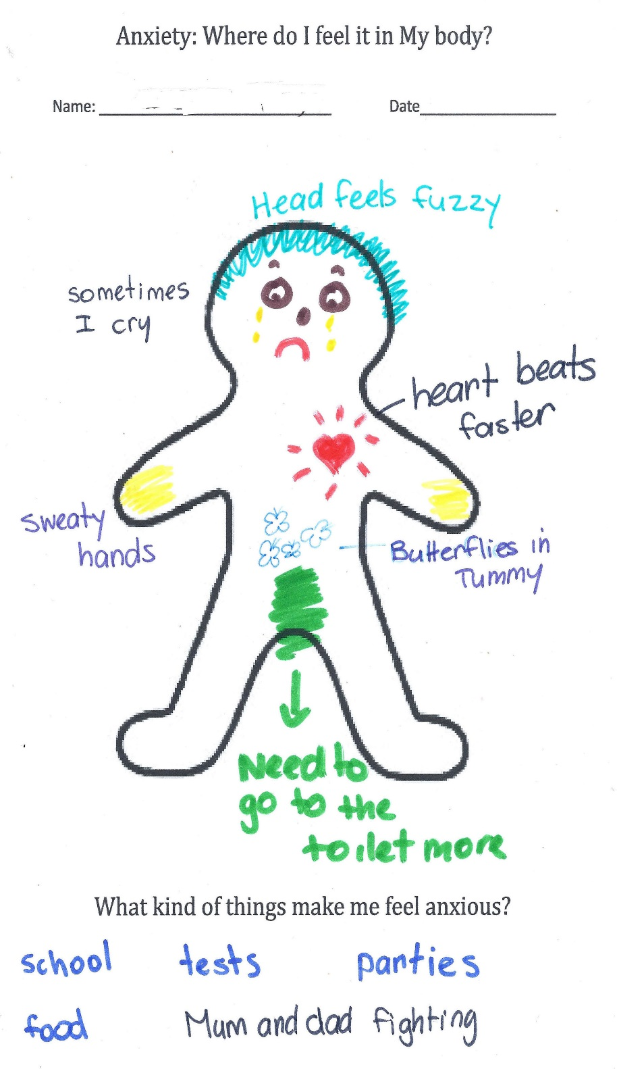
Draw a gingerbread person and give it a name. Get the young person to draw/write on the person all the physical things they notice about what happens when they are worried/anxious.

Slide 16
How can you help?
Open ended questions are good! What is going through your mind? Why are you worried? What do you think will happen? What is it about this situation that makes you worried?
How you ask is also important – their fears are real to them. They need to know that you are asking because you want to understand the worries better in order to help.
Use creative ways for your child to express their thoughts and feelings, e.g. worry box, thought diary etc. If they try to suppress their thoughts they are likely to feel more anxious.
You could structure in some talk time so you can help your child contain some of their thoughts and feelings.

Slide 17
Key points
Ask your child to express what is worrying them during the event or as soon as possible afterwards.
Show your interest and support in the way you ask the questions.
Keep an open mind – Don’t assume you know what they are thinking.
Ask open questions – ‘What’ and ‘Why’.
If necessary make suggestions – wonder out loud with your child
Repeat your understanding back to them to make sure you have understood correctly

Slide 18
Step 2 - Evaluate your child’s anxious thoughts
It is all about more helpful ways for your child to think about the situation. Help your child consider alternative thoughts.
What is the evidence for and against that the thought is true?
What makes you feel that (the feared situation) will happen?
Have you seen that happen to anyone else?
How likely is that (feared situation) likely to happen?
You can ask them to rate out of ‘10’ how definite they are.
Could you live through it? 3 What’s the best that could happen? How does believing this thought impact on you? How could changing this thought impact on you? How would someone else you respect think about this situation? What actually happened the last time you were in this situation? What if it does happen/ if it is true, what would be so bad about that?

Slide 19
Encourage them to draw on previous positive experiences. Are you assuming that you know what other people are thinking/ what it will be like without actually finding out?
Encourage your child to rate how definite they are that their thought is true and after some thinking time ask them whether their rating has changed. You can use a visual scale like a ladder.
Work as a team and try to hold back from drawing conclusions for your child. If your child thinks things through by himself/ herself they are more likely to remember.
HOLD BACK REASSURANCE
Be creative and make it fun when possible

Slide 20

Being a Detective – unpicking unhelpful thoughts
Detective Evidence sheet – Helpful thinking
Event What is happening? | A big dog came towards me
Thoughts What am I thinking | The dog is going to bite me Worry rating: 9
What is the evidence? What are the facts? What else could happen? What happened when I worried before? What is likely to happen? What has happened to other people? | The dog could walk by and not notice me. Other dogs have come up to me before and they didn’t bite me. Most people keep dogs as pets, not as guard dogs Most dogs are playful and affectionate The dog may be friendly and will want me to pat him
What is my helpful thought? | The dog might really just want to play with me Worry rating: 2

Slide 21
Step 3 - encouraging independence and ‘having a go’.
Give positive attention to your child when they have a go
Praise - Be clear and specific rather than general and vague e.g. ‘I bet …….was really scary, but you didn’t let that stop you. Well done.’
Rewards - They do not need to cost money! Small goals are rewarded with small rewards. Negotiate with your child. Rewards should be given as soon as possible after the achievement.

Slide 22
Key points
Be on the look out for when your child is ‘having a go’, i.e. not avoiding fears.
Praise and reward ‘having a go’
Set a good example of how to manage fears/ worries
Give a clear message that they can have a go and that they can cope
Your response is key…..
Over reassurance can also fuel anxiety by making them feel that there is something to be worried about. Wonder with them and help them reflect on their thoughts, feelings and behaviour. Help them find alternative thoughts. Praise
Stand back and let them have a go. Try to manage your own anxieties.

Slide 23
Step 4 - Facing Fear
Fears don’t go away unless we face up to them
Taking a gradual approach is important, and try not to have too many steps.
Start with a step the child does some of the time already
Make a plan - Draw up a clear step by step plan together focusing on the goals you are aiming for
1. Identify your child’s ultimate goal and ultimate reward 2. List steps towards the ultimate goal 3. Ask your child to rate the steps from the least difficult to the most difficult (Scale from 0-10). 4. Specifically reward each step 5. Take your time 6. It’s a good idea to repeat each step until the child feels confident. 7. What if the steps do not go well? - It is still important to praise for having a go

Slide 24
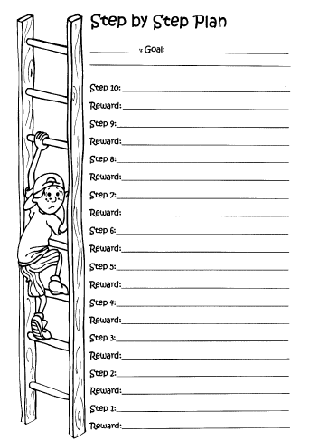
Creating a step-plan
  Identify ultimate goal and reward
  List steps towards ultimate goals
  Rate the steps from least to most scary
  Specify a reward for each step
  Ensure steps are practically possible

Slide 25
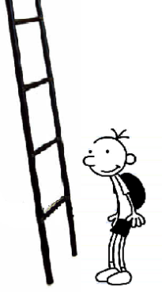
Example of Ladder - handouts
  I stay upstairs for 5 mins
  I walk upstairs and into my room on my own
  I walk up to the top of stairs on my own
  Mum stands at bottom of stairs I go to the top
  Mum stands at bottom of stairs, I go up half way
Going up stairs on my own…
Notes:
2.25

Slide 26
Step 5 - Problem Solving
It is tempting to solve the anxious child’s problems for him. That’s not to say they shouldn’t ask for help – that’s part of problem solving.
Step By Step 1. Be clear what the problem is 2. Think of many solutions as possible with your child 3. Weighing up the pros and cons of each possible solution and decide which is the best. 4. Give gentle prompts – What would someone else do in this situation? 5. Helpful questions – 6 What would happen if you did…..? What would happen in the end…..? What would make the difference….? How would that change how you would feel if that problem came up again?

Slide 27
Other ideas
Encourage your child to imagine something which might be anxiety provoking and explain that they are watching it like a film. You can then ask them to play, stop, pause, rewind etc and ask them what is happening. You could then ask your child to record over it in their mind and imagine them coping with the situation or doing something different.
Any type of relaxation exercises may be helpful – these aim to reduce muscle tension, control breathing and create calming mental imagery. Encourage your child to visualise a happy/calm place or something that they have overcome etc.
Create a visual reminder for your child of different things they can do to help them feel more settled/ relaxed and direct them to this.

Slide 28
Talking to your child:
Be open and available to talk - Make a time of the day when you can worry. It sounds strange but it is affective. Create a relax space to start a conversation.
If they are reluctant to talk, it may be best to try and have a chat while doing an activity (particularly if you can do it when side-by-side),
  Play a ball Game
  Bake a cake
  Take a walk
  Go for a drive
  Do some crafts - Any other ideas?
It is important to listen to their concerns and acknowledge them without minimising them.
Talk about how they can help themselves

Slide 29
Conversation Starters Ref:youngminds.co.uk
General
How are you feeling? What was the best and worst bit of your day?
What did you do today that you are most proud of?
Serious
What was the biggest problem you had today? Do you want to talk about what's going on? How can I support you through [issue]?
Fun
What's your favourite song at the moment? Would I like it? If you were any animal which one would you be? What's your favourite thing about school and why?
Encouragers
I love you, nothing can ever change that. You can talk to me, I'm here for you
If you talk to me about what is worrying you, I can do my best to help
We're going to get through this together

Slide 30
Helping to keep them calm:
Chill out Zone
Time alone – door signs – not in the mood leave me alone!
Rating scales – Colours, Numbers,
Physical Activities
A Hug
Talk things through
Sensory snacks
Controlled Breathing
Deep Pressure
Write or draw things down
Listen to loud Music
*Put Together Visuals to help them remember
Notes:
2.15
Colour wrist bands for their moods
WHAT Works for your child.

Slide 31
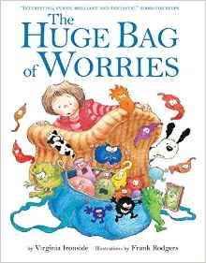
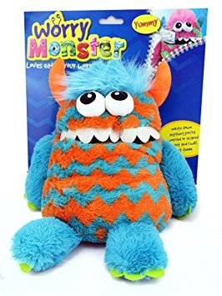
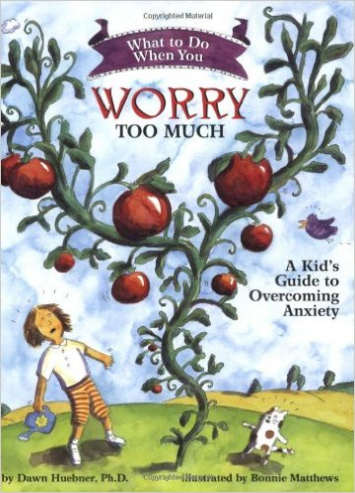
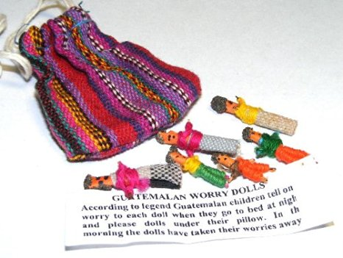
Other resources

Slide 32
What else?
Referral to CAMHS – anxiety and depression pathway
Time to Talk – free counselling service for 11 +
Kooth – online mental well being community
School - ELSA
Mental Health Support Team
www.anxietyuk.org.uk
www.youngminds.org.uk
www.autism.org.uk/aipanxiety
www.elsa-support.co.uk/

Slide 33
Look After Yourself
Take care of yourself as well as them – are there other people who can support, listen, and help you? This could be a long and difficult journey with many up’s and downs.

